Slide 1
The HoTT/HoTT Library in Coq Designing for Speed
Jason Gross
Massachusetts Institute of Technology
For ICMS 2016, adapted from ITP 2014 presentation
Category theory work done with Adam Chlipala and David I. Spivak
HoTT/HoTT library additionally co-authored by Andrej Bauer, Peter LeFanu Lumsdaine, Mike Shulman, Bas Spitters, and includes contributions from Assia Mahboubi, Marc Bezem, Kristina Sojakova, Daniel R. Grayson, Gaetan Gilbert, Matthieu Sozeau, Jérémy Ledent, Kevin Quirin, Steve Awodey, Cyril Cohen, Egbert, Benedikt Ahrens, Edward Z. Yang, Georgy Dunaev, Jesse C. McKeown, Simon Boulier, Alexander Karpich, Jelle Herold, John Dougherty, Matěj Grabovský, Michael Nahas, and Yves Bertot

Slide 2
How should theorem provers work?
Notes:
No audience participation

Slide 3

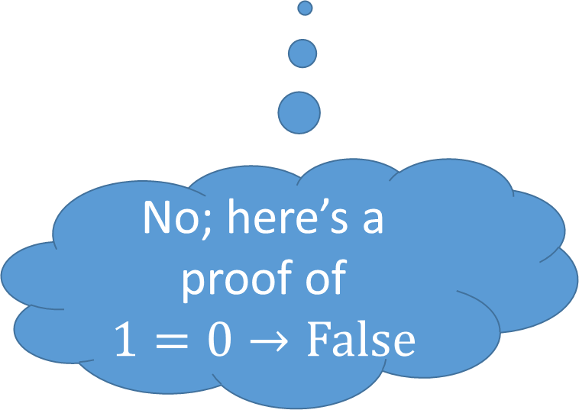
How theorem provers should work:
1 = 0
Coq, is this correct?
No; here’s a proof of
$$1=0→\text{False}$$

Slide 4

How theorem provers should work:
Theorem (currying) : $\left(C_{1}→\left(C_{2}→D\right)\right)≅(C_{1}×C_{2}→D)$
Proof: homework $∎$
Coq, is this correct?
Yes; here’s a proof …
Notes:
Ok, maybe not that simple

Slide 5

How theorem provers should work:
Theorem (currying) : $\left(C_{1}→\left(C_{2}→D\right)\right)≅(C_{1}×C_{2}→D)$
Proof: homework $∎$
Theorem currying : $\left(C_{1} →\left(C_{2}→D\right)\right)≅\left(C_{1}×C_{2}→D\right)$.
Proof.
trivial.
Qed.
Notes:
Ok, maybe not even this simple

Slide 6
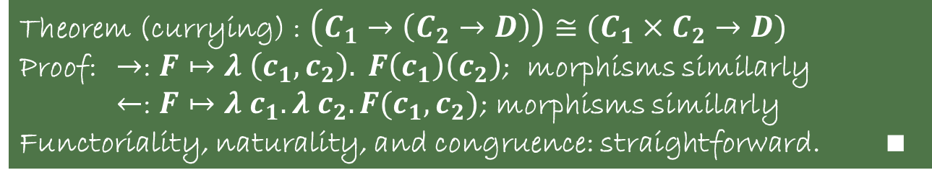

How theorem provers should work:
Theorem (currying) : $\left(C_{1}→\left(C_{2}→D\right)\right)≅(C_{1}×C_{2}→D)$
Proof: $→$: $F↦λ \left(c_{1}, c_{2}\right). F\left(c_{1}\right)\left(c_{2}\right)$; morphisms similarly
$←$: $F↦λ c_{1}. λ c_{2}. F(c_{1}, c_{2})$; morphisms similarly
Functoriality, naturality, and congruence: straightforward. $∎$
Theorem currying : $\left(C_{1} →\left(C_{2}→D\right)\right)≅\left(C_{1}×C_{2}→D\right)$.
Proof.
esplit.
{ by refine ($λ_{F}$ ($F↦$ ($λ_{F}$ ($c↦F_{o} c_{1} c_{2}$)))). }
{ by refine ($λ_{F}$ ($F↦$ ($λ_{F}$ ($c_{1}↦$ $\text{(}λ_{F}$ $\text{ (}c_{2}↦F_{o} (c_{1},c_{2}))$))))). }
all: trivial.
Qed.
Notes:
And maybe we’d also need to say what “morphisms similarly” means

Slide 7

How theorem provers should work:
Theorem (currying) : $\left(C_{1}→\left(C_{2}→D\right)\right)≅(C_{1}×C_{2}→D)$
Proof: $→$: $F↦λ \left(c_{1}, c_{2}\right). F\left(c_{1}\right)\left(c_{2}\right)$; morphisms similarly
$←$: $F↦λ c_{1}. λ c_{2}. F(c_{1}, c_{2})$; morphisms similarly
Functoriality, naturality, and congruence: straightforward. $∎$
Theorem currying : $\left(C_{1} →\left(C_{2}→D\right)\right)≅\left(C_{1}×C_{2}→D\right)$.
Proof.
esplit.
{ by refine ($λ_{F}$ ($F↦$ ($λ_{F}$ ($c↦F_{o} c_{1} c_{2}$) ($s d m↦{\left(F_{o} d_{1}\right)}_{m} m_{2}∘{\left(F_{m} m_{1}\right)}_{o} s_{2}$))
($F G T↦$ ($λ_{T}$ ($c↦T c_{1} c_{2}$)))). }
{ by refine ($λ_{F}$ ($F↦$ ($λ_{F}$ ($c_{1}↦$ $\text{(}λ_{F}$ $\text{ (}c_{2}↦F_{o} (c_{1},c_{2}))$ $\text{ (}s d m↦F_{m} (1,m))$))
($F G T↦$ ($λ_{T}$ ($c_{1}↦$ $\text{(}λ_{T}$ ($c_{2}↦T (c_{1},c_{2})$))))). }
all: trivial.
Qed.
Notes:
This is mostly realistic (in v8.5), but need specialized tactics

Slide 8

How theorem provers do work:
17 s
2m 46 s !!!
Theorem (currying) : $\left(C_{1}→\left(C_{2}→D\right)\right)≅(C_{1}×C_{2}→D)$
Proof: $→$: $F↦λ \left(c_{1}, c_{2}\right). F\left(c_{1}\right)\left(c_{2}\right)$; morphisms similarly
$←$: $F↦λ c_{1}. λ c_{2}. F(c_{1}, c_{2})$; morphisms similarly
Functoriality, naturality, and congruence: straightforward. $∎$
$≈$ 0 s
(5 s, if we use UIP)
Theorem currying : $\left(C_{1} →\left(C_{2}→D\right)\right)≅\left(C_{1}×C_{2}→D\right)$.
Proof.
esplit.
{ by refine ($λ_{F}$ ($F↦$ ($λ_{F}$ ($c↦F_{o} c_{1} c_{2}$) ($s d m↦{\left(F_{o} d_{1}\right)}_{m} m_{2}∘{\left(F_{m} m_{1}\right)}_{o} s_{2}$))
($F G T↦$ ($λ_{T}$ ($c↦T c_{1} c_{2}$)))). }
{ by refine ($λ_{F}$ ($F↦$ ($λ_{F}$ ($c_{1}↦$ $\text{(}λ_{F}$ $\text{ (}c_{2}↦F_{o} (c_{1},c_{2}))$ $\text{ (}s d m↦F_{m} (1,m))$))
($F G T↦$ ($λ_{T}$ ($c_{1}↦$ $\text{(}λ_{T}$ ($c_{2}↦T (c_{1},c_{2})$))))). }
all: trivial.
Qed.
Notes:
But rather slow (8.4 numbers)
Maybe there are fancy ways to speed this up; I’ve only put a little time into optimizing this proof.

Slide 9

Performance is important!
If we’re not careful, obvious or trivial things can be very, very slow.

Slide 10
Why you should listen to me
Theorem : You should listen to me.
Proof.
by experience.
Qed.

Slide 11
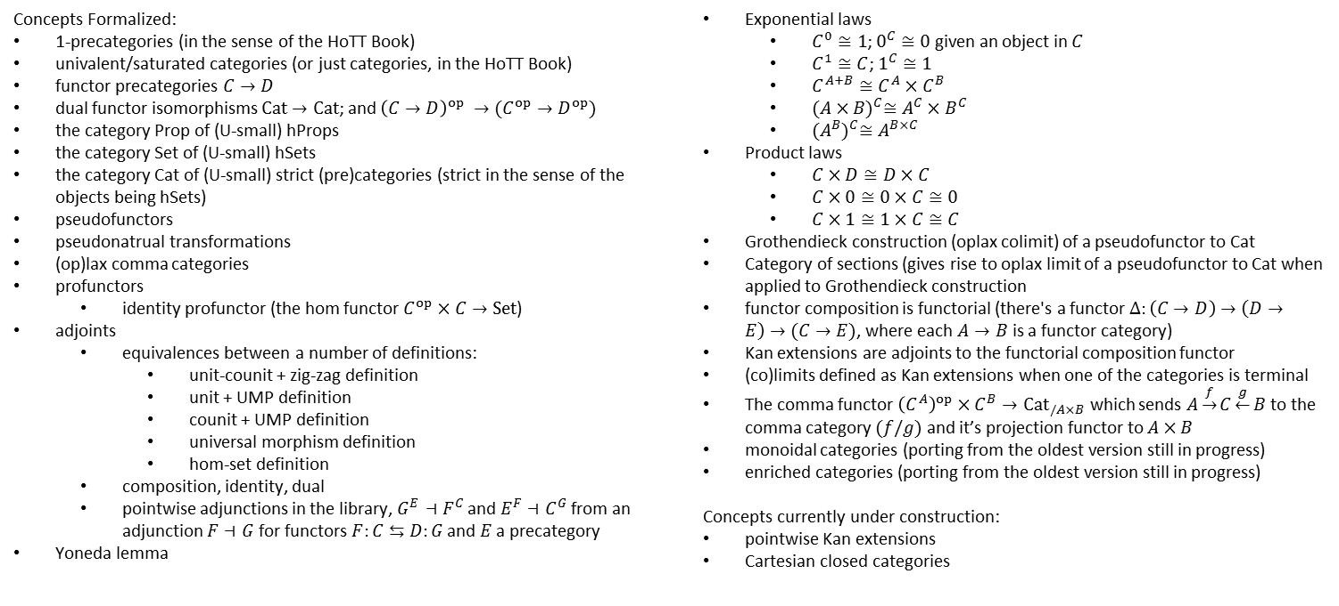
Why you should listen to me
Category theory in Coq: https://github.com/HoTT/HoTT (subdirectory theories/categories):
Concepts Formalized:
1-precategories (in the sense of the HoTT Book)
univalent/saturated categories (or just categories, in the HoTT Book)
functor precategories $C→D$
dual functor isomorphisms $\text{Cat}→\text{Cat}$; and ${\left(C→D\right)}^{op} →(C^{op}→D^{op})$
the category Prop of (U-small) hProps
the category Set of (U-small) hSets
the category Cat of (U-small) strict (pre)categories (strict in the sense of the objects being hSets)
pseudofunctors
pseudonatrual transformations
(op)lax comma categories
profunctors
identity profunctor (the hom functor $C^{op}×C→Set$)
adjoints
equivalences between a number of definitions:
unit-counit + zig-zag definition
unit + UMP definition
counit + UMP definition
universal morphism definition
hom-set definition
composition, identity, dual
pointwise adjunctions in the library, $G^{E}⊣F^{C}$ and $E^{F}⊣C^{G}$ from an adjunction $F⊣G$ for functors $F:C⇆D:G$ and $E$ a precategory
Yoneda lemma
Exponential laws
$C^{0}≅1$; $0^{C}≅0$ given an object in $C$
$C^{1}≅C$; $1^{C}≅1$
$C^{A+B}≅C^{A}×C^{B}$
${(A×B)}^{C}≅A^{C}×B^{C}$
${(A^{B})}^{C}≅A^{B×C}$
Product laws
$C×D≅D×C$
$C×0≅0×C≅0$
$C×1≅1×C≅C$
Grothendieck construction (oplax colimit) of a pseudofunctor to Cat
Category of sections (gives rise to oplax limit of a pseudofunctor to Cat when applied to Grothendieck construction
functor composition is functorial (there's a functor $Δ:\left(C→D\right)→\left(D→E\right)→(C→E)$, where each $A→B$ is a functor category)
Kan extensions are adjoints to the functorial composition functor
(co)limits defined as Kan extensions when one of the categories is terminal
The comma functor ${\left(C^{A}\right)}^{op}×C^{B}→{Cat}_{/A×B}$ which sends $A\underset{→}{f}C\underset{←}{g}B$ to the comma category $(f/g)$ and it’s projection functor to $A×B$
monoidal categories (porting from the oldest version still in progress)
enriched categories (porting from the oldest version still in progress)
Concepts currently under construction:
pointwise Kan extensions
Cartesian closed categories
Notes:
My hope is that the lessons will be useful for engineers of large formalized developments, and proof assistant designers.

Slide 12
Presentation is not mainly about:
Notes:
-

Slide 13
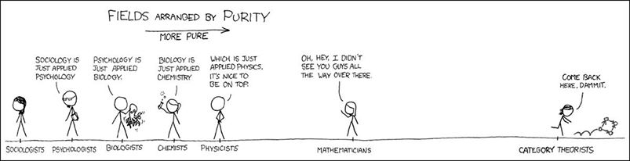
Presentation is not mainly about:
category theory or diagram chasing
Cartoon from xkcd, adapted by Alan Huang
Notes:
- I’d love to chat about it in person later, though.

Slide 14

Presentation is not mainly about:
category theory or diagram chasing
the mathematical content of the library
Cartoon from xkcd, adapted by Alan Huang
categories
HoTT/HoTT
Notes:
Though I'm happy to tell you more about it later

Slide 15
Presentation is not mainly about:
category theory or diagram chasing
the mathematical content of the library
Coq
Cartoon from xkcd, adapted by Alan Huang
categories
HoTT/HoTT
Notes:
But does include overview of the library

Slide 16
Presentation is not mainly about:
category theory or diagram chasing
the mathematical content of the library
Coq (though what I say might not always generalize nicely)
Cartoon from xkcd, adapted by Alan Huang
categories
HoTT/HoTT
Notes:
uses the medium of Coq
mentions much that is specific to it
might not generalize to other proof assistants and type theories

Slide 17

Presentation is about:
performance
the design of proof assistants and type theories to assist with performance
the kind of performance issues I encountered
an overview of the content of the HoTT/HoTT library
Notes:
Proofs in category theory are often simple ➔ I‘ll not talk about speeding up tactics (for tricky reasoning or exhaustive search)
Hint: The issues I’ve encountered almost all center around term size

Slide 18
Presentation is for:
Homotopy type theorists
Who are interested in the HoTT/HoTT library
Users of proof assistants (and Coq in particular)
Who want to make their code faster
Designers of (type-theoretic) proof assistants
Who want to know where to focus their optimization efforts

Slide 19
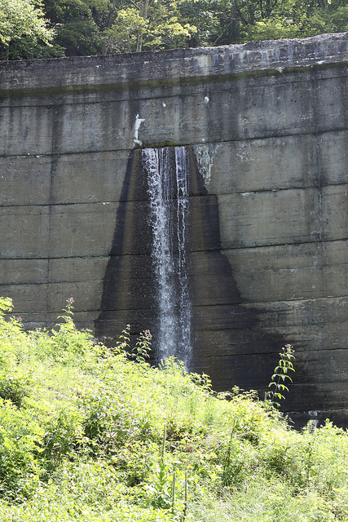
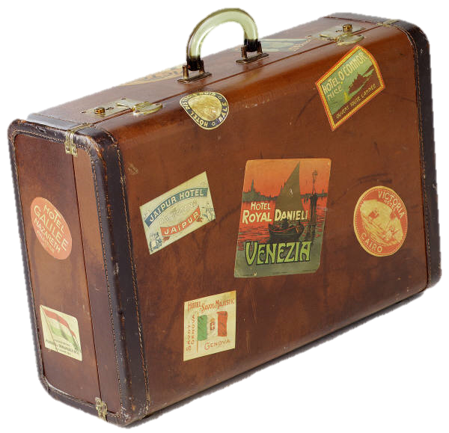

Outline
Why should we care about performance?
Overview of the HoTT/HoTT library
What makes theorem provers (mainly Coq) slow?
Examples of particular slowness
For users (workarounds)
Arguments vs. fields and packed records
Proof by duality as proof by unification
Abstraction barriers
For developers (features)
Primitive projections
Higher inductive types
Universe Polymorphism
Universes image from Abell NGC2218 hst big, NASA, http://en.wikipedia.org/wiki/Abell_2218#mediaviewer/File:Abell_NGC2218_hst_big.jpg, released in Public Domain; Bubble from http://pixabay.com/en/blue-bubble-shiny-157652/, released in Public Domain CC0, combined in Photoshop by Jason Gross
Dam image from http://www.flickr.com/photos/gammaman/7803829282/ by Eli Christman, CC by 2.0

Slide 20
HoTT/HoTT Library
Notes:
Core library; brown=basics, red=tactics, blue-violet=basic types, black=modalities, orange=hits, green=everything else, not-included: categories

Slide 21
HoTT/HoTT Library
Notes:
Adding categories; basic library still on the left

Slide 22
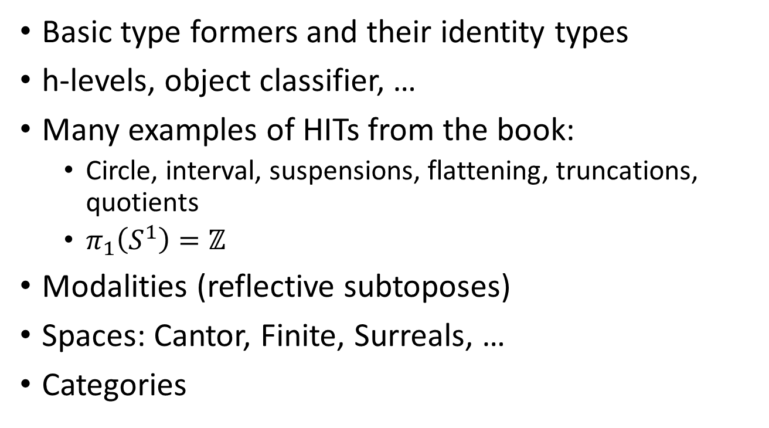
HoTT/HoTT Library: Contents
Basic type formers and their identity types
h-levels, object classifier, …
Many examples of HITs from the book:
Circle, interval, suspensions, flattening, truncations, quotients
$π_{1}\left(S^{1}\right)=ℤ$
Modalities (reflective subtoposes)
Spaces: Cantor, Finite, Surreals, …
Categories

Slide 23
HoTT/HoTT Library: Design
Liberal use of Coq features
Modules
Used extensively in modalities (reflective subtoposes)
Universe polymorphism (not Type:Type)
Used extensively in modalities (reflective subtoposes), cumulative hierarchy
Typeclasses for tracking homotopy levels, axioms
Records with primitive projections and η for Σ-types
Higher inductive types via Licata trick
Axiomatize non-exported paths in a module
Contributions via pull requests on GitHub

Slide 24
Performance
Question: What makes programs, particularly theorem provers or proof scripts, slow?
Notes:
No audience participation

Slide 25
Performance
Question: What makes programs, particularly theorem provers or proof scripts, slow?
Answer: Doing too much stuff!
Notes:
Ok, great, but when can we fix this?

Slide 26
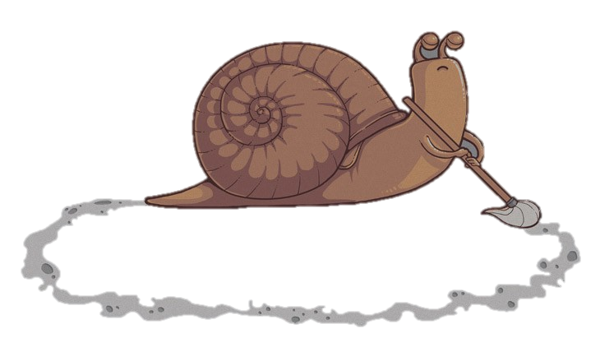
Performance
Question: What makes programs, particularly theorem provers or proof scripts, slow?
Answer: Doing too much stuff!
doing the same things repeatedly
Snail from http://naolito.deviantart.com/art/Repetitive-task-258126598
Notes:
“License”:
Re: Permission to use an image of yours? from Naolito to JasonSG
Hi Jason, Thanks for asking me, please feel free to use it for that matter, I always allow to use my images as long as they are not sold Sorry for the late response, I barely check my deviantart inbox, mail would be better next time! Thanks, Nacho ---------- JasonSG said the following: Hi, I would like to use your Repetitive Task image (naolito.deviantart.com/art/Rep… in a slideshow for a presentation I'm giving at a computer science conference, and posting on my website. Would you be willing to release it under a creative commons license or similar? Thanks, Jason

Slide 27
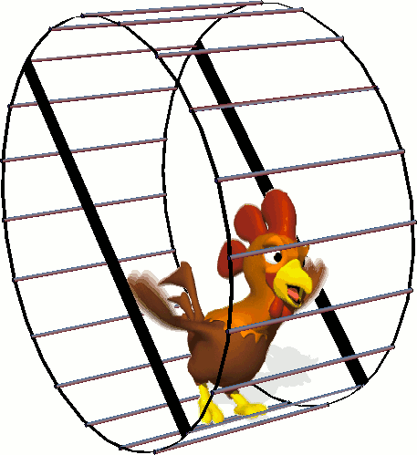
Performance
Question: What makes programs, particularly theorem provers or proof scripts, slow?
Answer: Doing too much stuff!
doing the same things repeatedly
doing lots of stuff for no good reason
Running rooster from http://d.wapday.com:8080/animation/ccontennt/15545-f/mr_rooster_running.gif
Notes:
Running roster also shows up at http://welldes.com/gif-animacija/pticy.html

Slide 28

Performance
Question: What makes programs, particularly theorem provers or proof scripts, slow?
Answer: Doing too much stuff!
doing the same things repeatedly
doing lots of stuff for no good reason
using a slow language when you could be using a quicker one
Notes:
In our case, it’s actually Ltac, Coq’s tactic language, and not Python that’s the slow language.

Slide 29
Proof assistant performance
What kinds of things does Coq do?
Type checking
Term building
Unification
Normalization
Notes:
(No audience participation)

Slide 30
Proof assistant performance (pain)
When are these slow?
when you duplicate work
when you do work on a part of a term you end up not caring about
when you do them too many times
when your term is large

Slide 31
Proof assistant performance (size)
How large is slow?
Notes:
- Ltac repeatedly typechecks terms, every time you add a piece to them

Slide 32
Proof assistant performance (size)
How large is slow?
Around 150,000—500,000 words

Slide 33
Notes:
“word” = “Set Printing All, then word counter”
Better in 8.6

Slide 34
Notes:
“word” = “Set Printing All, then word counter”
Better in 8.6

Slide 35
Proof assistant performance (size)
How large is slow?
Around 150,000—500,000 words
Do terms actually get this large?

Slide 36
Proof assistant performance (size)
How large is slow?
Around 150,000—500,000 words
Do terms actually get this large?
YES!

Slide 37
Proof assistant performance (size)
A directed graph has:
a type of vertices (points)
for every ordered pair of vertices, a type of arrows
category
Notes:
Note that the type of edges from one vertex to another doesn’t have to be discrete, nor finite
Idea generalizes to “category” in the library

Slide 38
Proof assistant performance (size)
A directed 2-graph has:
a type of vertices (0-arrows)
for every ordered pair of vertices, a type of arrows (1-arrows)
for every ordered pair of 1-arrows between the same vertices, a type of 2-arrows
2-category
Notes:
We can iterate this construction. N-categories get slow very, very quickly. (2-categories are already slow)

Slide 39
Proof assistant performance (size)
A directed arrow-graph comes from turning arrows into vertices:
functor
category
Notes:
There’s a way of looking at this arrow-graph as a vertex of a 2-graph, so we can iterate this construction. Nested functor categories are slow.

Slide 40
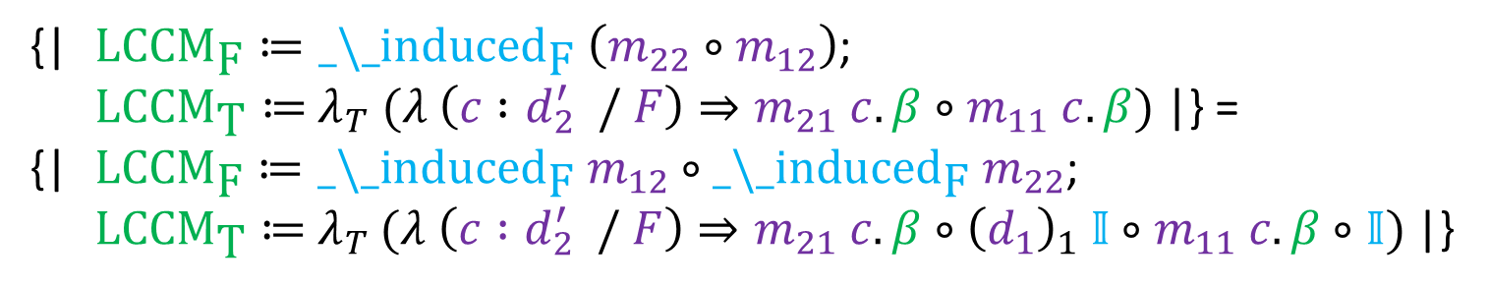
Proof assistant performance (pain)
When are these slow?
When your term is large
Smallish example (29 000 words): Without Proofs:
{| ${\text{LCCM}}_{\text{F}}≔{\text{_}\text{\backslash }\text{_}\text{induced}}_{\text{F}} \left(m_{22}∘m_{12}\right)$;
${\text{LCCM}}_{\text{T}}≔$ $λ_{T} (λ \left(c :d_{2}^{′} / F\right)⇒m_{21} c. β∘m_{11} c. β)$ |} =
{| ${\text{LCCM}}_{\text{F}}≔{\text{_}\text{\backslash }\text{_}\text{induced}}_{\text{F}} m_{12}∘{\text{_}\text{\backslash }\text{_}\text{induced}}_{\text{F}} m_{22}$;
${\text{LCCM}}_{\text{T}}≔$ $λ_{T}$ $(λ \left(c :d_{2}^{′} / F\right)⇒m_{21} c. β∘{\left(d_{1}\right)}_{1} 𝕀∘m_{11} c. β∘𝕀)$|}
Kan Extensions
Notes:
-

Slide 41
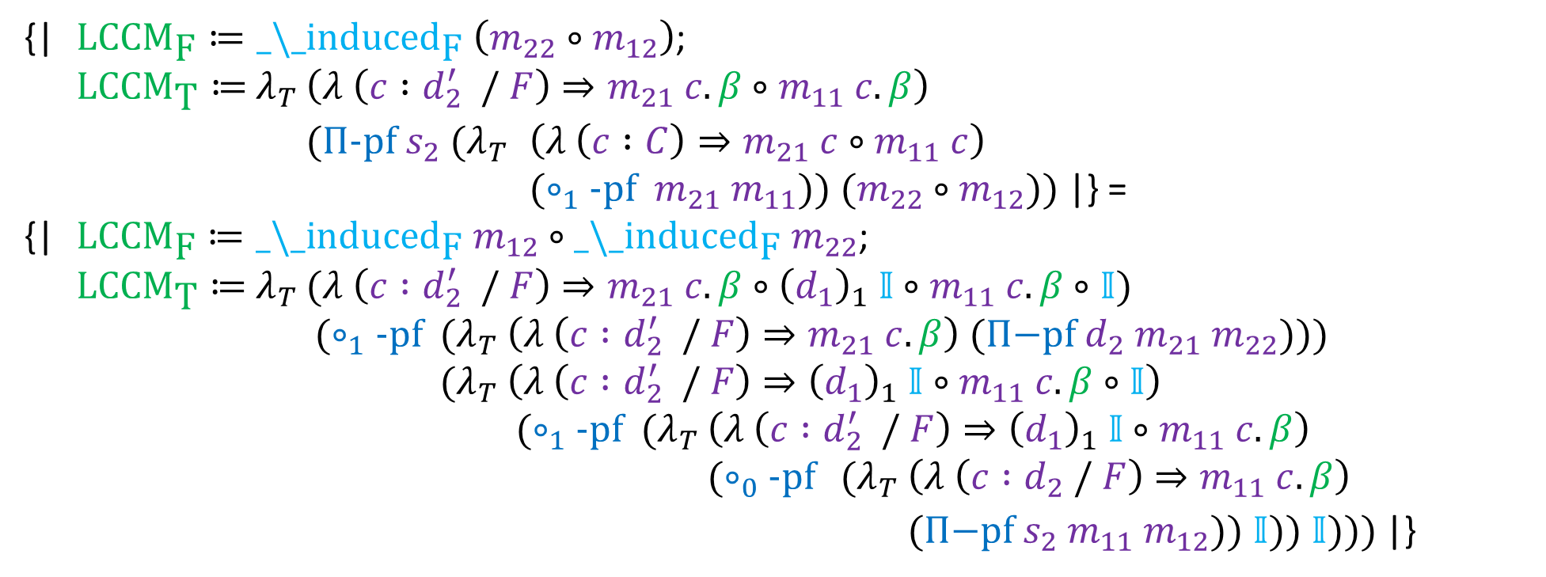
Proof assistant performance (pain)
When are these slow?
When your term is large
Smallish example (29 000 words): Without Proofs:
{| ${\text{LCCM}}_{\text{F}}≔{\text{_}\text{\backslash }\text{_}\text{induced}}_{\text{F}} \left(m_{22}∘m_{12}\right)$;
${\text{LCCM}}_{\text{T}}≔$ $λ_{T}$ $\left(λ \left(c :d_{2}^{′} / F\right)⇒m_{21} c. β∘m_{11} c. β\right)$
$(Π\text{−}\text{pf} s_{2} (λ_{T}$ $\left(λ \left(c :C\right)⇒m_{21} c∘m_{11} c\right)$
$(∘_{1}\text{−}\text{pf} m_{21} m_{11})) (m_{22}∘m_{12}))$ |} =
{| ${\text{LCCM}}_{\text{F}}≔{\text{_}\text{\backslash }\text{_}\text{induced}}_{\text{F}} m_{12}∘{\text{_}\text{\backslash }\text{_}\text{induced}}_{\text{F}} m_{22}$;
${\text{LCCM}}_{\text{T}}≔$ $λ_{T}$ $(λ \left(c :d_{2}^{′} / F\right)⇒m_{21} c. β∘{\left(d_{1}\right)}_{1} 𝕀∘m_{11} c. β∘𝕀)$
$(∘_{1}\text{−}\text{pf}$ $(λ_{T}$ $\left(λ \left(c :d_{2}^{′} / F\right)⇒m_{21} c. β\right)$ $(Π\text{−}\text{pf} d_{2} m_{21} m_{22}\text{)}\text{))}$
$(λ_{T}$ $\left(λ \left(c :d_{2}^{′} / F\right)⇒{\left(d_{1}\right)}_{1} 𝕀∘m_{11} c. β∘𝕀\right)$
$(∘_{1}\text{−}\text{pf}$ $(λ_{T}$ $\left(λ \left(c :d_{2}^{′} / F\right)⇒{\left(d_{1}\right)}_{1} 𝕀∘m_{11} c. β\right)$
$(∘_{0}\text{−}\text{pf}$ $(λ_{T}$ $\left(λ \left(c :d_{2} / F\right)⇒m_{11} c. β\right)$
$(Π\text{−}\text{pf} s_{2} m_{11} m_{12})) 𝕀)) 𝕀)))$ |}
Kan Extensions
Notes:
Many, many implicit arguments are hidden here by notations
Biggest culprit is (nested) arguments to opaque proofs that don’t matter

Slide 42
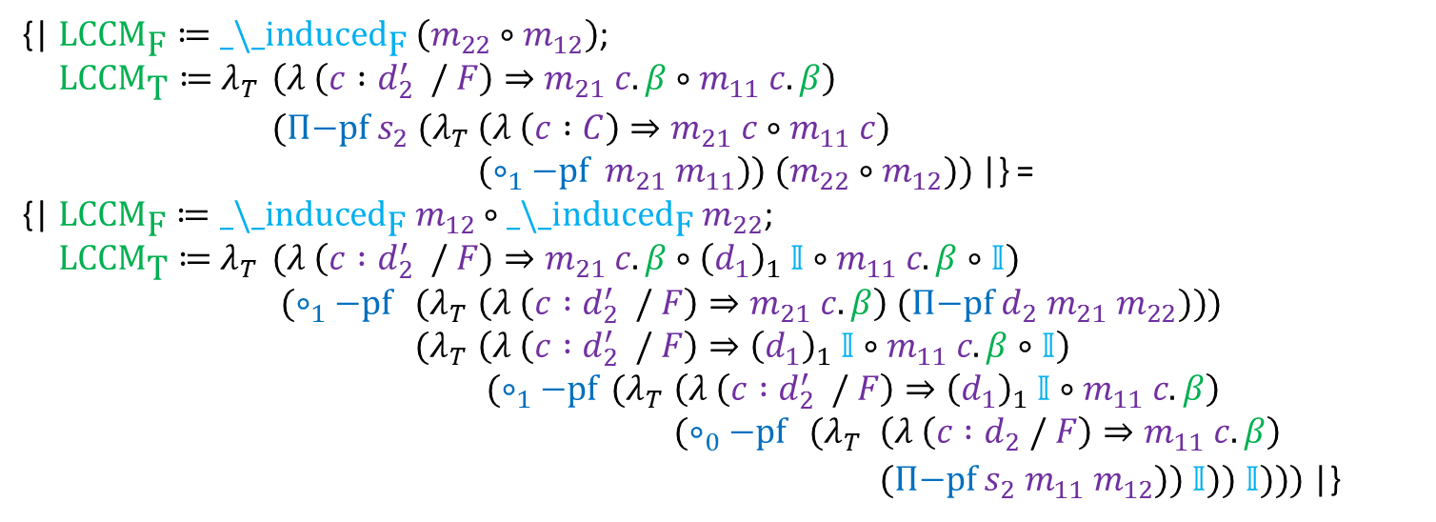
Proof assistant performance (pain)
When are these slow?
When your term is large
Smallish example (29 000 words): Without Proofs:
{| ${\text{LCCM}}_{\text{F}}≔{\text{_}\text{\backslash }\text{_}\text{induced}}_{\text{F}} \left(m_{22}∘m_{12}\right)$;
${\text{LCCM}}_{\text{T}}≔$ $λ_{T}$ $\left(λ \left(c :d_{2}^{′} / F\right)⇒m_{21} c. β∘m_{11} c. β\right)$
$(Π\text{−}\text{pf} s_{2} (λ_{T}$ $\left(λ \left(c :C\right)⇒m_{21} c∘m_{11} c\right)$
$(∘_{1}\text{−}\text{pf} m_{21} m_{11})) (m_{22}∘m_{12}))$ |} =
{| ${\text{LCCM}}_{\text{F}}≔{\text{_}\text{\backslash }\text{_}\text{induced}}_{\text{F}} m_{12}∘{\text{_}\text{\backslash }\text{_}\text{induced}}_{\text{F}} m_{22}$;
${\text{LCCM}}_{\text{T}}≔$ $λ_{T}$ $(λ \left(c :d_{2}^{′} / F\right)⇒m_{21} c. β∘{\left(d_{1}\right)}_{1} 𝕀∘m_{11} c. β∘𝕀)$
$(∘_{1}\text{−}\text{pf}$ $(λ_{T}$ $\left(λ \left(c :d_{2}^{′} / F\right)⇒m_{21} c. β\right)$ $(Π\text{−}\text{pf} d_{2} m_{21} m_{22}\text{)}\text{))}$
$(λ_{T}$ $\left(λ \left(c :d_{2}^{′} / F\right)⇒{\left(d_{1}\right)}_{1} 𝕀∘m_{11} c. β∘𝕀\right)$
$(∘_{1}\text{−}\text{pf}$ $(λ_{T}$ $\left(λ \left(c :d_{2}^{′} / F\right)⇒{\left(d_{1}\right)}_{1} 𝕀∘m_{11} c. β\right)$
$(∘_{0}\text{−}\text{pf}$ $(λ_{T}$ $\left(λ \left(c :d_{2} / F\right)⇒m_{11} c. β\right)$
$(Π\text{−}\text{pf} s_{2} m_{11} m_{12})) 𝕀)) 𝕀)))$ |}
Kan Extensions
Notes:
Many, many implicit arguments are hidden here by notations
Biggest culprit is (nested) arguments to opaque proofs that don’t matter

Slide 43
Proof assistant performance (fixes)
How do we work around this?

Slide 44

Proof assistant performance (fixes)
How do we work around this?
By hiding from the proof checker!
Fence from http://imgarcade.com/1/hiding-clipart/

Slide 45
Proof assistant performance (fixes)
How do we work around this?
By hiding from the proof checker!
How do we hide?

Slide 46
Proof assistant performance (fixes)
How do we work around this?
By hiding from the proof checker!
How do we hide?
Good engineering
Better proof assistants
Notes:
Two options: abstract things from user point of view (fence), or into the metatheory (rocket rooster)

Slide 47
Proof assistant performance (fixes)
Careful Engineering

Slide 48
Outline
Why should we care about performance?
Overview of the HoTT/HoTT library
What makes theorem provers (mainly Coq) slow?
Examples of particular slowness
For users (workarounds)
Arguments vs. fields and packed records
Proof by duality as proof by unification
Abstraction barriers
For developers (features)
Primitive projections
Higher inductive types
Universe Polymorphism
Dam image from http://www.flickr.com/photos/gammaman/7803829282/ by Eli Christman, CC by 2.0

Slide 49
Proof assistant performance (fixes)
How?
Pack your records!
Notes:
-

Slide 50
Proof assistant performance (fixes)
How?
Pack your records!
A mapping of graphs is a mapping of vetices to vertices and arrows to arrows
mapping
Functor
Notes:
- The obvious mappings of arrows have been elided

Slide 51
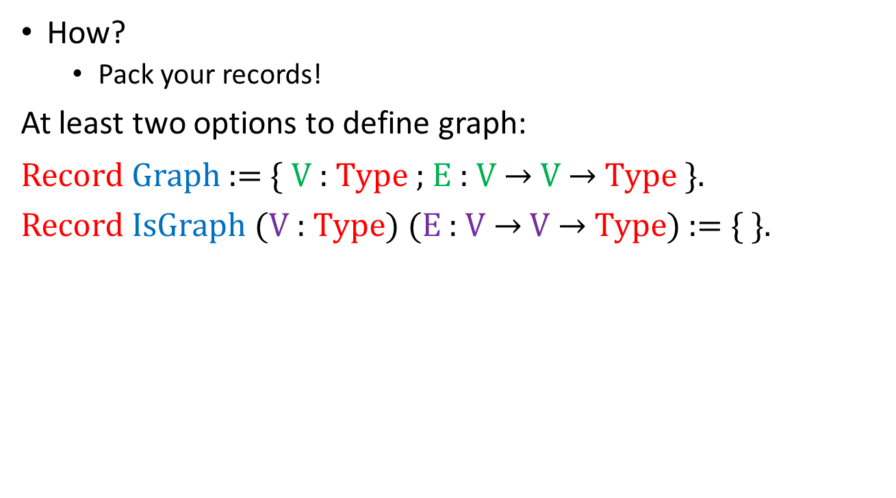
Proof assistant performance (fixes)
How?
Pack your records!
At least two options to define graph:
Record Graph := { V : Type ; E : V $→$ V $→$ Type }.
Record IsGraph (V : Type) (E : V $→$ V $→$ Type) := { }.
Category
Notes:
-

Slide 52
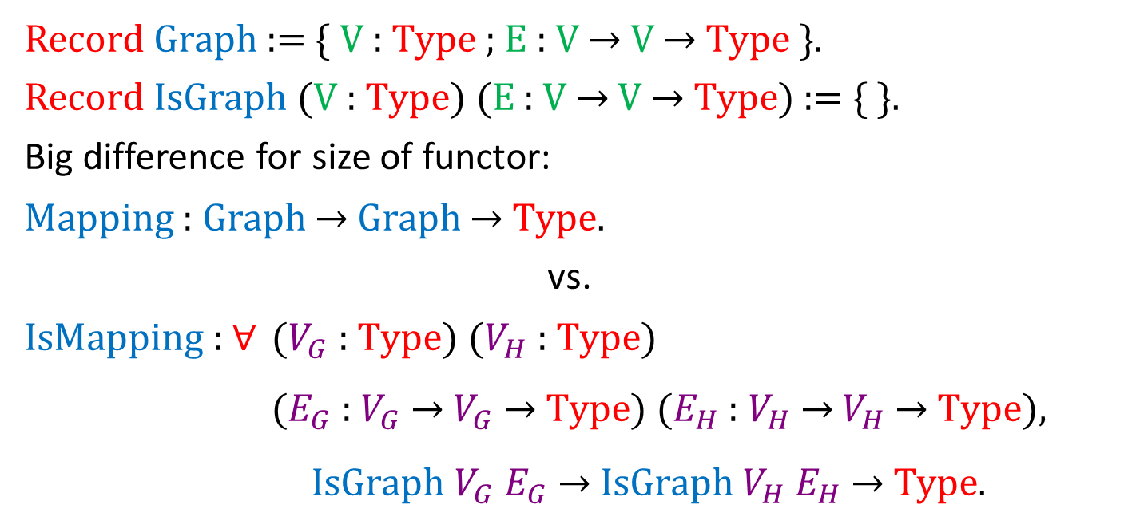
Proof assistant performance (fixes)
Record Graph := { V : Type ; E : V → V → Type }.
Record IsGraph ($V$: Type) ($E$: $V$→ $V$→ Type) := { }.
Big difference for size of functor:
Mapping : Graph → Graph → Type.
vs.
IsMapping : ∀ ($V_{G}$ : Type) ($V_{H}$ : Type)
($E_{G}$ : $V_{G}$ → $V_{G}$ → Type) ($E_{H}$ : $V_{H}$ → $V_{H}$ → Type),
IsGraph $V_{G}$ $E_{G}$ → IsGraph $V_{H}$ $E_{H}$ → Type.
Categories &
Functors
Notes:
- Even worse for maps between functors

Slide 53
Proof assistant performance (fixes)
How?
Exceedingly careful engineering to get proofs for free
Notes:
-

Slide 54
Proof assistant performance (fixes)
Duality proofs for free
Notes:
-

Slide 55
Proof assistant performance (fixes)
Duality proofs for free
Idea: One proof, two theorems
Notes:
-

Slide 56
Proof assistant performance (fixes)
Duality proofs for free
Recall: A directed graph has:
a type of vertices (points)
for every ordered pair of vertices, a type of arrows
category

Slide 57
Proof assistant performance (fixes)
Duality proofs for free
Two vertices are isomorphic if there is exactly one edge between them in each direction
isomorphism

Slide 58
Proof assistant performance (fixes)
Duality proofs for free
Two vertices are isomorphic if there is exactly one edge between them in each direction
An initial (bottom) vertex is a vertex with exactly one edge to every other vertex
initial
object

Slide 59
Proof assistant performance (fixes)
Duality proofs for free
Two vertices are isomorphic if there is exactly one edge between them in each direction
An initial (bottom) vertex is a vertex with exactly one edge to every other vertex
A terminal (top) vertex is a vertex with exactly one edge from every other vertex
terminal
object

Slide 60
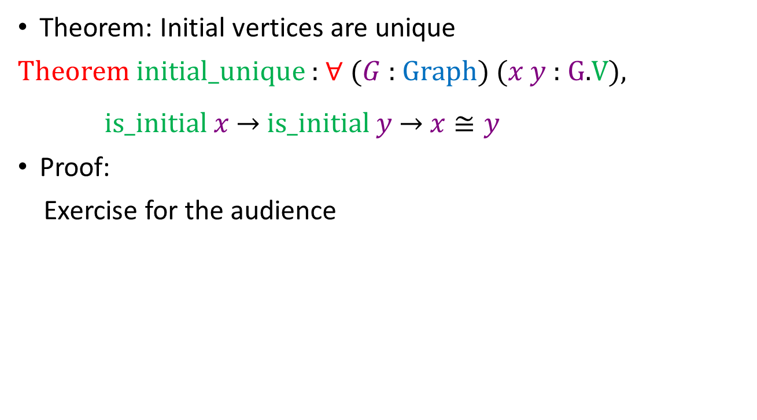
Proof assistant performance (fixes)
Theorem: Initial vertices are unique
Theorem initial_unique : ∀ ($G$ : Graph) ($x$ $y$ : $G$.V),
is_initial $x$ → is_initial $y$ → 𝑥 ≅ 𝑦
Proof:
Exercise for the audience
Notes:
-

Slide 61
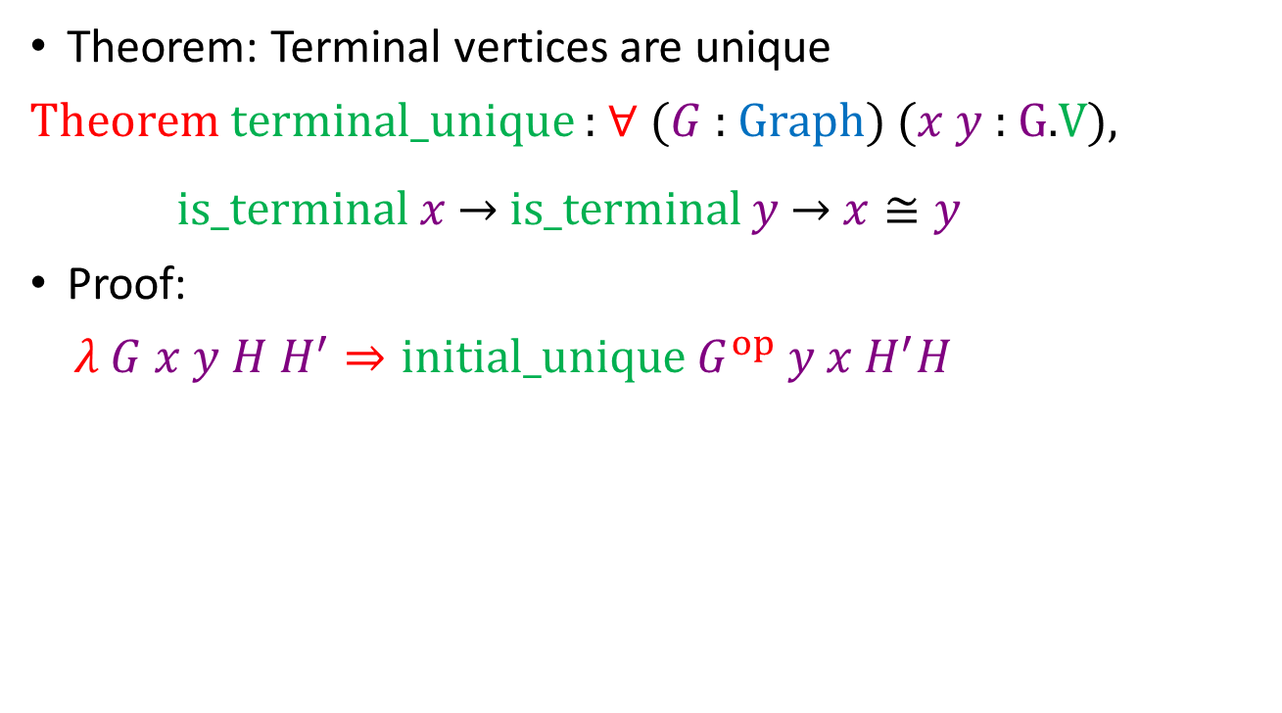
Proof assistant performance (fixes)
Theorem: Terminal vertices are unique
Theorem terminal_unique : ∀ ($G$ : Graph) ($x$ $y$ : $G$.V),
is_terminal $x$ $→$ is_terminal $y$ $→$ $x≅y$
Proof:
$λ G x y H H^{′}⇒\text{initial}\text{_}\text{unique} G^{op} y x H^{′}H$
Notes:
Pretty neat
There are a number of tricks that you have to use to get this to work; I’m happy to talk about them later, or you can see my paper

Slide 62
Proof assistant performance (fixes)
How?
Either don’t nest constructions, or don't unfold nested constructions
Coq only cares about unnormalized term size – “What I don't know can't hurt me”
Notes:
- The ConCaT, Constructive Category Theory, contribution takes the former route----but code reuse and modularity are nice

Slide 63
Proof assistant performance (fixes)
How?
More systematically, have good abstraction barriers
Notes:
-

Slide 64
Proof assistant performance (fixes)
How?
Have good abstraction barriers
Leaky abstraction barriers generally only torture programmers
Dam image from http://www.flickr.com/photos/gammaman/7803829282/ by Eli Christman, CC by 2.0

Slide 65
Proof assistant performance (fixes)
How?
Have good abstraction barriers
Leaky abstraction barriers torture Coq, too!
Dam image from http://www.flickr.com/photos/gammaman/7803829282/ by Eli Christman, CC by 2.0
Notes:
- Leaky abstraction barriers means Coq has to unfold definitions to notice that they match. Coq might not be very good at this, so in the worst case <next slide>

Slide 66
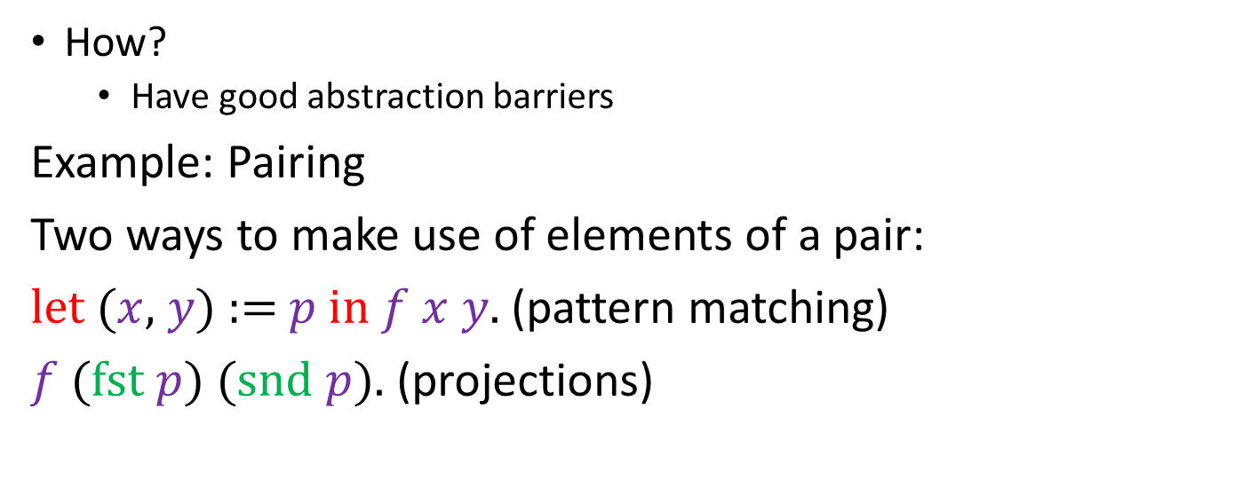
Proof assistant performance (fixes)
How?
Have good abstraction barriers
Example: Pairing
Two ways to make use of elements of a pair:
let ($x$, $y$) := $p$ in $f$ $x$ $y$. (pattern matching)
$f$ (fst $p$) (snd $p$). (projections)
Notes:
- Or, equivalently, <next slide>

Slide 67
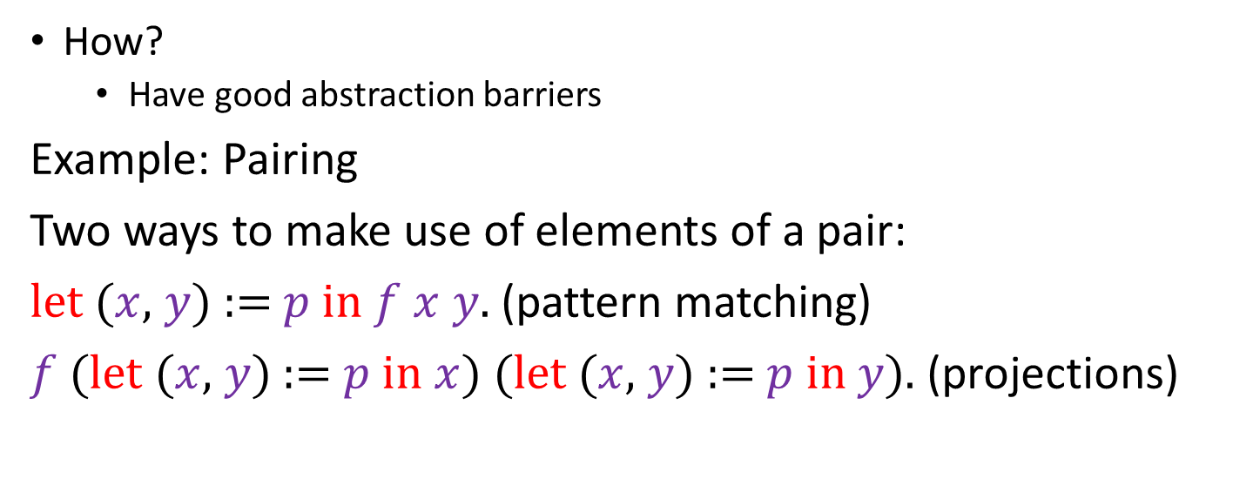
Proof assistant performance (fixes)
How?
Have good abstraction barriers
Example: Pairing
Two ways to make use of elements of a pair:
let ($x$, $y$) := $p$ in $f$ $x$ $y$. (pattern matching)
$f$ (let ($x$, $y$) := $p$ in $x$) (let ($x$, $y$) := $p$ in $y$). (projections)
These ways do not unify!
Notes:
If you mix them, you break the abstraction barrier of pairs
If you mix them under binders, you need functional extensionality to get back equality
If you then need to coerce with that equality involving functional extensionality, and prove something about the resulting terms…

Slide 68
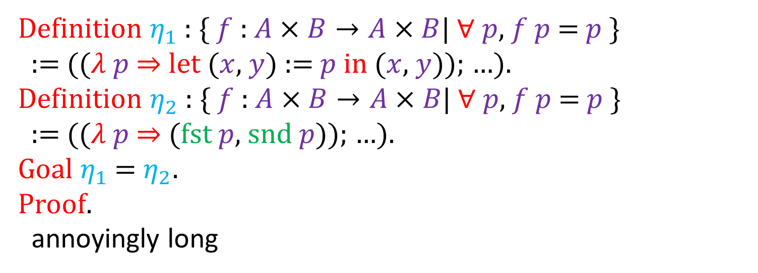
Proof assistant performance (fixes)
How?
Have good abstraction barriers
Example: Pairing
Definition $η_{1}$ : { $f$ : $A×B→A×B$| $∀$ $p$, $f$ $p$ = $p$ }
:= (($λ$ $p$ $⇒$ let ($x$, $y$) := $p$ in ($x$, $y$)); …).
Definition $η_{2}$ : { $f$ : $A×B→A×B$| $∀$ $p$, $f$ $p$ = $p$ }
:= (($λ$ $p$ $⇒$ (fst $p$, snd $p$)); …).
Goal $η_{1}$ = $η_{2}$.
Proof.
annoyingly long
Notes:
If you mix them, you break the abstraction barrier of pairs
If you mix them under binders, you need functional extensionality to get back equality
If you then need to coerce with that equality involving functional extensionality, and prove something about the resulting terms…

Slide 69

Proof assistant performance (fixes)
How?
Have good abstraction barriers
Leaky abstraction barriers torture Coq, too!
Rooster Image from http://www.animationlibrary.com/animation/18342/Chicken_blows_up/
Dam image from http://www.flickr.com/photos/gammaman/7803829282/ by Eli Christman, CC by 2.0
Notes:
You get terrible things. But in any case, regardless of whether or not your rooster blows himself up, you get <next slide>

Slide 70
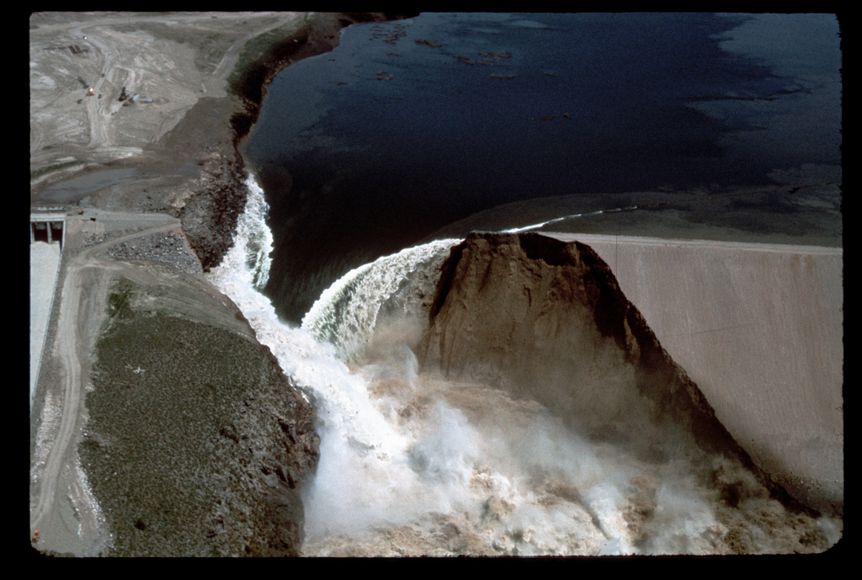
Proof assistant performance (fixes)
How?
Have good abstraction barriers
Leaky abstraction barriers torture Coq, too!
Dam image from ID-L-0010, WaterArchives.org, CC by SA 2.0
Notes:
a rather terrible leak. Either because you have lots of work, or because Coq has lots of unfolding to do.

Slide 71
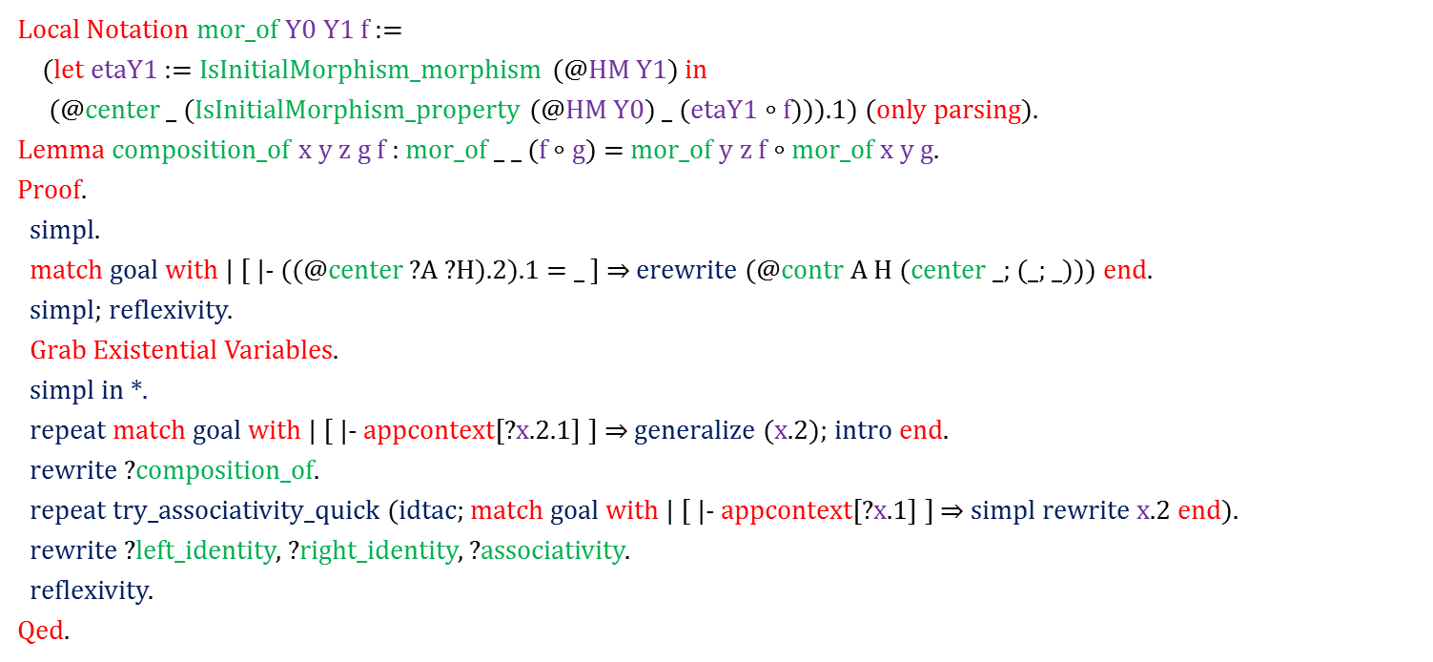
Proof assistant performance (fixes)
Concrete Example (Old Version)
Local Notation mor_of $Y_{0}$ $Y_{1}$ $f$:=
(let $η_{Y_{1}}$:= IsInitialMorphism_morphism (@HM $Y_{1}$) in
(@center _ (IsInitialMorphism_property (@HM $Y_{0}$) _ ($η_{Y_{1}}∘$ f)))$_{1}$ ) (only parsing).
Lemma composition_of $x$ $y$ $z$ $g$ $f$: mor_of _ _ ($f∘$ $g$) = mor_of $y$ $z$ $f∘$ mor_of $x$ $y$ $g$.
Proof.
simpl.
match goal with | [ ⊢ ((@center ?$A$?$H$)$_{2}$)$_{1}$= _ ] $⇒$ erewrite (@contr $A$ $H$ (center _; (_; _))) end.
simpl; reflexivity.
Grab Existential Variables.
simpl in ∗.
repeat match goal with | [ ⊢ appcontext[(?$x _{2}$)$_{1}$ ] ] $⇒$ generalize ($x _{2}$); intro end.
rewrite ?composition_of.
repeat try_associativity_quick (idtac; match goal with | [ ⊢ appcontext[?$x _{1}$] ] $⇒$ simpl rewrite $x _{2}$ end).
rewrite ?left_identity, ?right_identity, ?associativity.
reflexivity.
Qed.
8 s
2 s
2.5 s
0.5 s
3.5 s
0.3 s
univeral
adjoints
Size of goal (after first simpl): 7312 words
Size of proof term: 66 264 words
Total time in file: 39 s
20 s
Notes:
I was able to get a factor of 10 speedup by plugging abstraction barrier holes.

Slide 72
Proof assistant performance (fixes)
Concrete Example (Old Version)
Local Notation mor_of $Y_{0}$ $Y_{1}$ $f$:=
(let $η_{Y_{1}}$:= IsInitialMorphism_morphism (@HM $Y_{1}$) in
(@center _ (IsInitialMorphism_property (@HM $Y_{0}$) _ ($η_{Y_{1}}∘$ f)))$_{1}$ ) (only parsing).
Lemma composition_of $x$ $y$ $z$ $g$ $f$: mor_of _ _ ($f∘$ $g$) = mor_of $y$ $z$ $f∘$ mor_of $x$ $y$ $g$.
Proof.
simpl.
match goal with | [ ⊢ ((@center ?$A$?$H$)$_{2}$)$_{1}$= _ ] $⇒$ erewrite (@contr $A$ $H$ (center _; (_; _))) end.
simpl; reflexivity.
Grab Existential Variables.
simpl in ∗.
repeat match goal with | [ ⊢ appcontext[(?$x _{2}$)$_{1}$ ] ] $⇒$ generalize ($x _{2}$); intro end.
rewrite ?composition_of.
repeat try_associativity_quick (idtac; match goal with | [ ⊢ appcontext[?$x _{1}$] ] $⇒$ simpl rewrite $x _{2}$ end).
rewrite ?left_identity, ?right_identity, ?associativity.
reflexivity.
Qed.
univeral
adjoints
Size of goal (after first simpl): 7312 words
Size of proof term: 66 264 words
Total time in file: 39 s

Slide 73
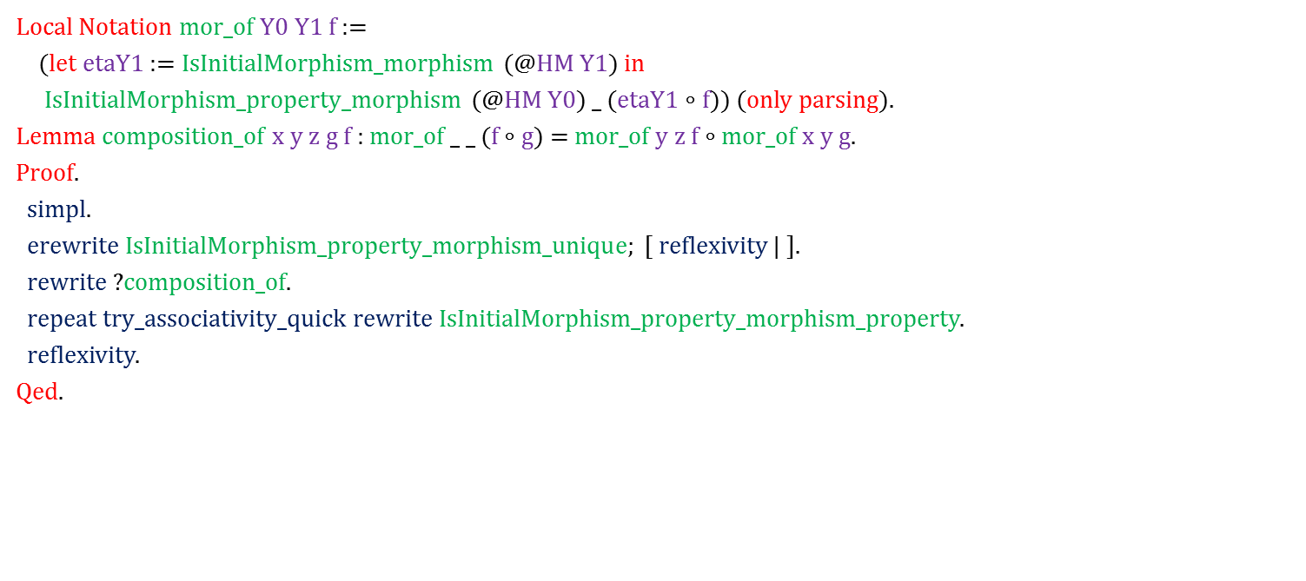
Proof assistant performance (fixes)
Concrete Example (New Version)
Local Notation mor_of $Y_{0}$ $Y_{1}$ $f$:=
(let $η_{Y_{1}}$:= IsInitialMorphism_morphism (@HM $Y_{1}$) in
IsInitialMorphism_property_morphism (@HM $Y_{0}$) _ ($η_{Y_{1}}∘$ $f$)) (only parsing).
Lemma composition_of $x$ $y$ $z$ $g$ $f$: mor_of _ _ ($f∘$ $g$) = mor_of $y$ $z$ $f∘$ mor_of $x$ $y$ $g$.
Proof.
simpl.
erewrite IsInitialMorphism_property_morphism_unique; [ reflexivity | ].
rewrite ?composition_of.
repeat try_associativity_quick rewrite IsInitialMorphism_property_morphism_property.
reflexivity.
Qed.
0.08 s
(was 10 s)
0.08 s
(was 0.5 s)
0.5 s
(was 3.5 s)
0.5 s
(was 3.5 s)
univeral
adjoints
Size of goal (after first simpl): 191 words (was 7312)
Size of proof term: 3 632 words (was 66 264)
Total time in file: 3 s (was 39 s)

Slide 74
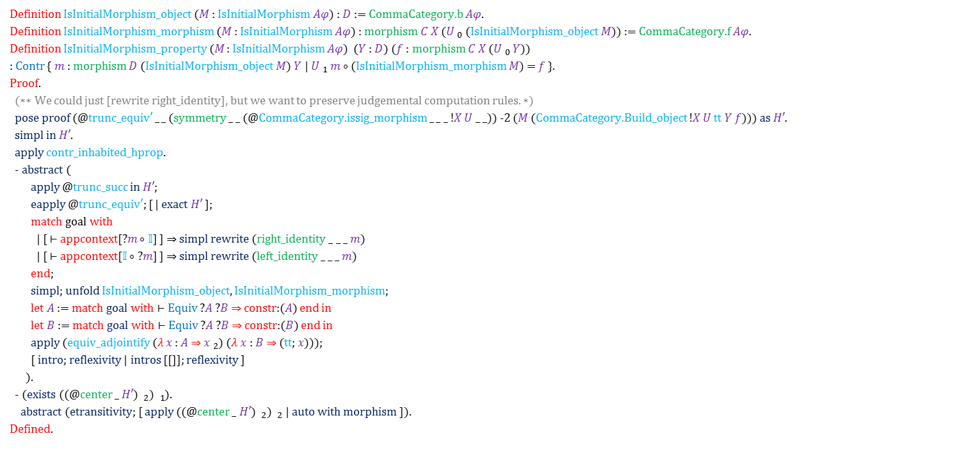
Proof assistant performance (fixes)
Concrete Example (Old Interface)
Definition IsInitialMorphism_object ($M$ : IsInitialMorphism $Aφ$) : $D$ := CommaCategory.b $Aφ$.
Definition IsInitialMorphism_morphism ($M$ : IsInitialMorphism $Aφ$) : morphism $C$ $X$ ($U _{0}$ (IsInitialMorphism_object $M$)) := CommaCategory.f $Aφ$.
Definition IsInitialMorphism_property ($M$ : IsInitialMorphism $Aφ$) ($Y$ : $D$) ($f$ : morphism $C$ $X$ ($U _{0}$ $Y$))
: Contr { $m$ : morphism $D$ (IsInitialMorphism_object $M$) $Y$ | $U _{1}$ $m$ $∘$ (IsInitialMorphism_morphism $M$) = $f$ }.
Proof.
(∗∗ We could just [rewrite right_identity], but we want to preserve judgemental computation rules. ∗)
pose proof (@trunc_equiv′ _ _ (symmetry _ _ (@CommaCategory.issig_morphism _ _ _ !$X$ $U$ _ _)) -2 ($M$ (CommaCategory.Build_object !$X$ $U$ tt $Y$ $f$))) as $H′$.
simpl in $H′$.
apply contr_inhabited_hprop.
- abstract (
apply @trunc_succ in $H′$;
eapply @trunc_equiv′; [ | exact $H′$ ];
match goal with
| [ ⊢ appcontext[?$m$ ∘ $𝕀$] ] $⇒$ simpl rewrite (right_identity _ _ _ $m$)
| [ ⊢ appcontext[$𝕀$ ∘ ?$m$] ] $⇒$ simpl rewrite (left_identity _ _ _ $m$)
end;
simpl; unfold IsInitialMorphism_object, IsInitialMorphism_morphism;
let $A$ := match goal with ⊢ Equiv ?$A$ ?$B$ $⇒$ constr:($A$) end in
let $B$ := match goal with ⊢ Equiv ?$A$ ?$B$ $⇒$ constr:($B$) end in
apply (equiv_adjointify ($λ$ $x$ : $A$ $⇒$ $x _{2}$) ($λ$ $x$ : $B$ $⇒$ (tt; $x$)));
[ intro; reflexivity | intros [[]]; reflexivity ]
).
- (exists ((@center _ $H′$) $_{2}$) $_{1}$).
abstract (etransitivity; [ apply ((@center _ $H′$) $_{2}$) $_{2}$ | auto with morphism ]).
Defined.
3 s
1 s
Total file time: 7 s

Slide 75
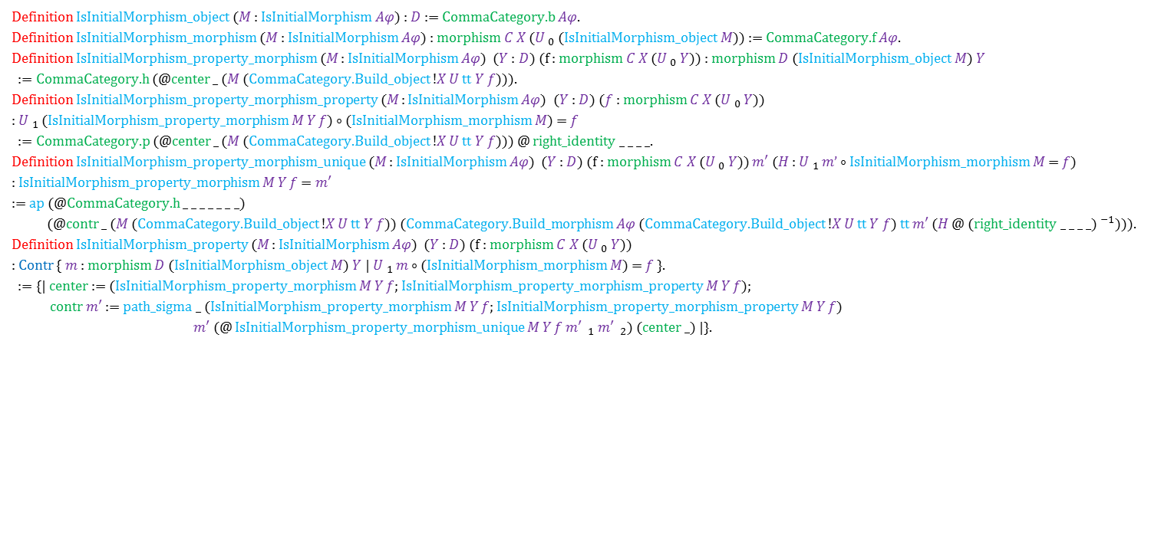
Proof assistant performance (fixes)
Concrete Example (New Interface)
Definition IsInitialMorphism_object ($M$ : IsInitialMorphism $Aφ$) : $D$ := CommaCategory.b $Aφ$.
Definition IsInitialMorphism_morphism ($M$ : IsInitialMorphism $Aφ$) : morphism $C$ $X$ ($U _{0}$ (IsInitialMorphism_object $M$)) := CommaCategory.f $Aφ$.
Definition IsInitialMorphism_property_morphism ($M$ : IsInitialMorphism $Aφ$) ($Y$ : $D$) (f : morphism $C$ $X$ ($U _{0}$ $Y$)) : morphism $D$ (IsInitialMorphism_object $M$) $Y$
:= CommaCategory.h (@center _ ($M$ (CommaCategory.Build_object !$X$ $U$ tt $Y$ $f$))).
Definition IsInitialMorphism_property_morphism_property ($M$ : IsInitialMorphism $Aφ$) ($Y$ : $D$) ($f$ : morphism $C$ $X$ ($U _{0}$ $Y$))
: $U _{1}$ (IsInitialMorphism_property_morphism $M$ $Y$ $f$) $∘$ (IsInitialMorphism_morphism $M$) = $f$
:= CommaCategory.p (@center _ ($M$ (CommaCategory.Build_object !$X$ $U$ tt $Y$ $f$))) @ right_identity _ _ _ _.
Definition IsInitialMorphism_property_morphism_unique ($M$ : IsInitialMorphism $Aφ$) ($Y$ : $D$) (f : morphism $C$ $X$ ($U _{0}$ $Y$)) $m′$ ($H$ : $U _{1}$ $m’$ $∘$ IsInitialMorphism_morphism $M$ = $f$)
: IsInitialMorphism_property_morphism $M$ $Y$ $f$ = $m′$
:= ap (@CommaCategory.h _ _ _ _ _ _ _)
(@contr _ ($M$ (CommaCategory.Build_object !$X$ $U$ tt $Y$ $f$)) (CommaCategory.Build_morphism $Aφ$ (CommaCategory.Build_object !$X$ $U$ tt $Y$ $f$) tt $m′$ ($H$ @ (right_identity _ _ _ _)$^{−1}$))).
Definition IsInitialMorphism_property ($M$ : IsInitialMorphism $Aφ$) ($Y$ : $D$) (f : morphism $C$ $X$ ($U _{0}$ $Y$))
: Contr { $m$ : morphism $D$ (IsInitialMorphism_object $M$) $Y$ | $U _{1}$ $m$ $∘$ (IsInitialMorphism_morphism $M$) = $f$ }.
:= {| center := (IsInitialMorphism_property_morphism $M$ $Y$ $f$; IsInitialMorphism_property_morphism_property $M$ $Y$ $f$);
contr $m′$ := path_sigma _ (IsInitialMorphism_property_morphism $M$ $Y$ $f$; IsInitialMorphism_property_morphism_property $M$ $Y$ $f$)
$m′$ (@ IsInitialMorphism_property_morphism_unique $M$ $Y$ $f$ $m′$ $_{1}$ $m′$ $_{2}$) (center _) |}.
0.4 s
Total file time: 7 s
Notes:
The code on screen together takes about 0.7 s. Much of the remaining time (~2.5 s) is spent dealing with building a representation in nested sigmas.
On next slide: A related technique: Generalizing terms and copy/pasting gives a smaller, but noticeable speedup (~x3). (Example: rather than destructing a big complicated pair, generalize it to an arbitrary pair.) Unfortunately, it generally takes me a few hours to do.

Slide 76
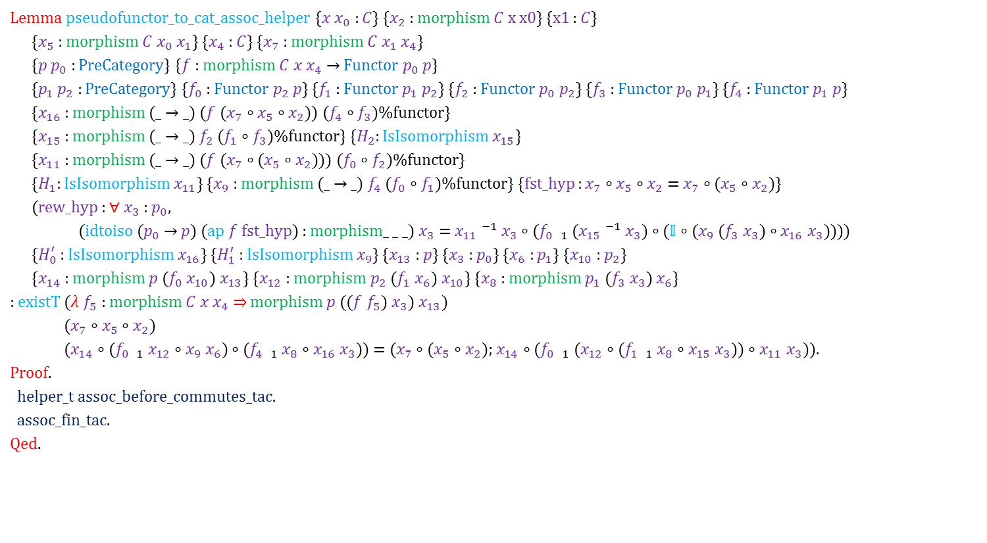
Proof assistant performance (fixes)
Concrete Example 2 (Generalization)
Lemma pseudofunctor_to_cat_assoc_helper {$x$ $x_{0}$ : $C$} {$x_{2}$ : morphism $C$ x x0} {x1 : $C$}
{$x_{5}$ : morphism $C$ $x_{0}$ $x_{1}$} {$x_{4}$ : $C$} {$x_{7}$ : morphism $C$ $x_{1}$ $x_{4}$}
{$p$ $p_{0}$ : PreCategory} {$f$ : morphism $C$ $x$ $x_{4}$ $→$ Functor $p_{0}$ $p$}
{$p_{1}$ $p_{2}$ : PreCategory} {$f_{0}$ : Functor $p_{2}$ $p$} {$f_{1}$ : Functor $p_{1}$ $p_{2}$} {$f_{2}$ : Functor $p_{0}$ $p_{2}$} {$f_{3}$ : Functor $p_{0}$ $p_{1}$} {$f_{4}$ : Functor $p_{1}$ $p$}
{$x_{16}$ : morphism (_ → _) ($f$ ($x_{7}$ ∘ $x_{5}$ ∘ $x_{2}$)) ($f_{4}$ ∘ $f_{3}$)%functor}
{$x_{15}$ : morphism (_ → _) $f_{2}$ ($f_{1}$ ∘ $f_{3}$)%functor} {$H_{2}$: IsIsomorphism $x_{15}$}
{$x_{11}$ : morphism (_ → _) ($f$ ($x_{7}$ ∘ ($x_{5}$ ∘ $x_{2}$))) ($f_{0}$ ∘ $f_{2}$)%functor}
{$H_{1}$: IsIsomorphism $x_{11}$} {$x_{9}$ : morphism (_ $→$ _) $f_{4}$ ($f_{0}$ ∘ $f_{1}$)%functor} {fst_hyp : $x_{7}$ ∘ $x_{5}$ ∘ $x_{2}$ = $x_{7}$ ∘ ($x_{5}$ ∘ $x_{2}$)}
(rew_hyp : $∀$ $x_{3}$ : $p_{0}$,
(idtoiso ($p_{0}$ → $p$) (ap $f$ fst_hyp) : morphism_ _ _) $x_{3}$ = $x_{11} ^{−1}$ $x_{3}$ ∘ ($f_{0}$ $_{1}$ ($x_{15} ^{−1}$ $x_{3}$) ∘ ($𝕀$ ∘ ($x_{9}$ ($f_{3}$ $x_{3}$) ∘ $x_{16}$ $x_{3}$))))
{$H_{0}^{′}$ : IsIsomorphism $x_{16}$} {$H_{1}^{′}$ : IsIsomorphism $x_{9}$} {$x_{13}$ : $p$} {$x_{3}$ : $p_{0}$} {$x_{6}$ : $p_{1}$} {$x_{10}$ : $p_{2}$}
{$x_{14}$ : morphism $p$ ($f_{0}$ $x_{10}$) $x_{13}$} {$x_{12}$ : morphism $p_{2}$ ($f_{1}$ $x_{6}$) $x_{10}$} {$x_{8}$ : morphism $p_{1}$ ($f_{3}$ $x_{3}$) $x_{6}$}
: existT (𝜆 $f_{5}$ : morphism $C$ $x$ $x_{4}$ ⇒ morphism $p$ (($f$ $f_{5}$) $x_{3}$) $x_{13}$)
($x_{7}$ ∘ $x_{5}$ ∘ $x_{2}$)
($x_{14}$ ∘ ($f_{0}$ $_{1}$ $x_{12}$ ∘ $x_{9}$ $x_{6}$) ∘ ($f_{4}$ $_{1}$ $x_{8}$ ∘ $x_{16}$ $x_{3}$)) = ($x_{7}$ ∘ ($x_{5}$ ∘ $x_{2}$); $x_{14}$ ∘ ($f_{0}$ $_{1}$ ($x_{12}$ ∘ ($f_{1}$ $_{1}$ $x_{8}$ ∘ $x_{15}$ $x_{3}$)) ∘ $x_{11}$ $x_{3}$)).
Proof.
helper_t assoc_before_commutes_tac.
assoc_fin_tac.
Qed.
Speedup: 10x for the file, from 4m 53s to 28 s
Time spent: a few hours
Notes:
Is it worth it? Very questionable.

Slide 77
Outline
Why should we care about performance?
Overview of the HoTT/HoTT library
What makes theorem provers (mainly Coq) slow?
Examples of particular slowness
For users (workarounds)
Arguments vs. fields and packed records
Proof by duality as proof by unification
Abstraction barriers
For developers (features)
Primitive projections
Higher inductive types
Universe Polymorphism
Dam image from http://www.flickr.com/photos/gammaman/7803829282/ by Eli Christman, CC by 2.0

Slide 78
Proof assistant performance (fixes)
Better Proof Assistants

Slide 79
Outline
Why should we care about performance?
Overview of the HoTT/HoTT library
What makes theorem provers (mainly Coq) slow?
Examples of particular slowness
For users (workarounds)
Arguments vs. fields and packed records
Proof by duality as proof by unification
Abstraction barriers
For developers (features)
Primitive projections
Higher inductive types
Universe Polymorphism
Universes image from Abell NGC2218 hst big, NASA, http://en.wikipedia.org/wiki/Abell_2218#mediaviewer/File:Abell_NGC2218_hst_big.jpg, released in Public Domain; Bubble from http://pixabay.com/en/blue-bubble-shiny-157652/, released in Public Domain CC0, combined in Photoshop by Jason Gross
Dam image from http://www.flickr.com/photos/gammaman/7803829282/ by Eli Christman, CC by 2.0

Slide 80
Proof assistant performance (fixes)
How?
Primitive projections
Notes:
- If you’re not careful, projections can blow up term size very quickly

Slide 81
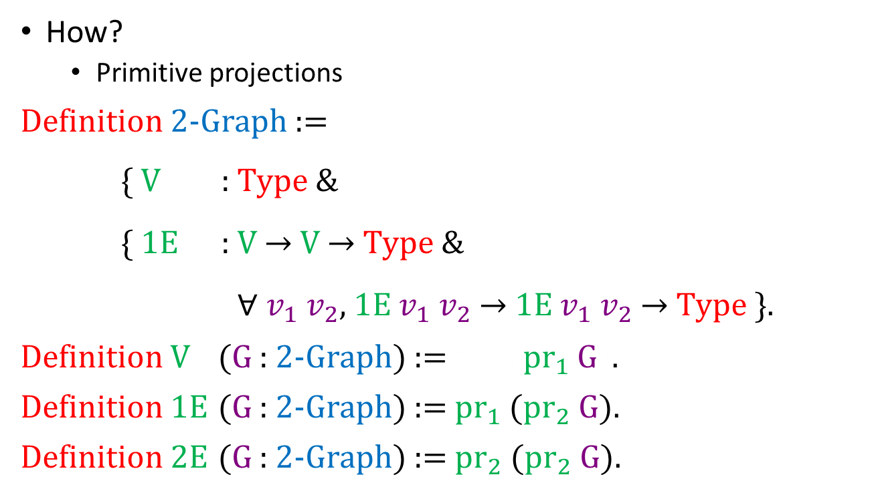
Proof assistant performance (fixes)
How?
Primitive projections
Definition 2-Graph :=
{ V : Type &
{ 1E : V $→$ V $→$ Type &
: $∀$ $v_{1}$ $v_{2}$, 1E $v_{1}$ $v_{2}$ $→$ 1E $v_{1}$ $v_{2}$ $→$ Type }.
Definition V (G : 2-Graph) := ${\text{pr}}_{1}$ (${\text{pr}}_{1}$ G).
Definition 1E (G : 2-Graph) := ${\text{pr}}_{1}$ (${\text{pr}}_{2}$ G).
Definition 2E (G : 2-Graph) := ${\text{pr}}_{2}$ (${\text{pr}}_{2}$ G).
Notes:
Consider a 2-graph, and defining the type of vertices and edges/arrows.
Looks compact enough, right?
Let’s make room to look at the implicit arguments <next slide>

Slide 82
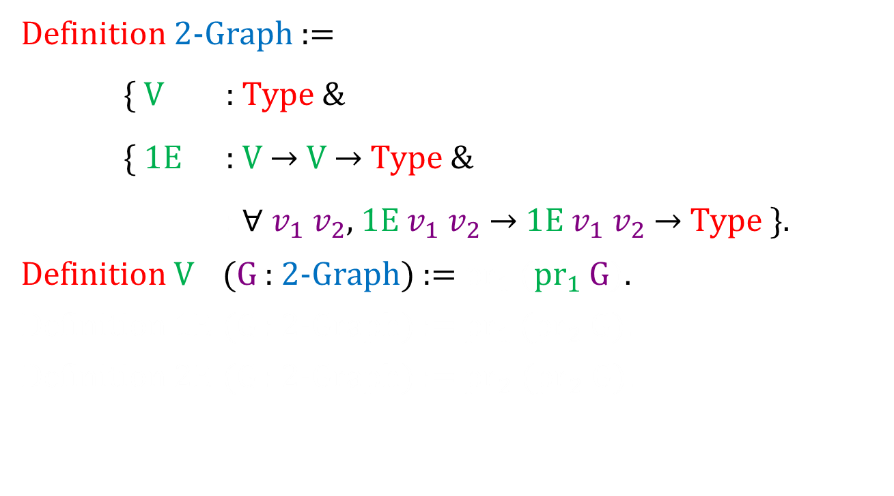
Proof assistant performance (fixes)
Definition 2-Graph :=
{ V : Type &
{ 1E : V $→$ V $→$ Type &
: $∀$ $v_{1}$ $v_{2}$, 1E $v_{1}$ $v_{2}$ $→$ 1E $v_{1}$ $v_{2}$ $→$ Type }.
Definition V (G : 2-Graph) := ${\text{pr}}_{1}$ (${\text{pr}}_{1}$ G).
Definition 1E (G : 2-Graph) := ${\text{pr}}_{1}$ (${\text{pr}}_{2}$ G).
Definition 2E (G : 2-Graph) := ${\text{pr}}_{2}$ (${\text{pr}}_{2}$ G).
Notes:
- Now we have a bit of room.

Slide 83
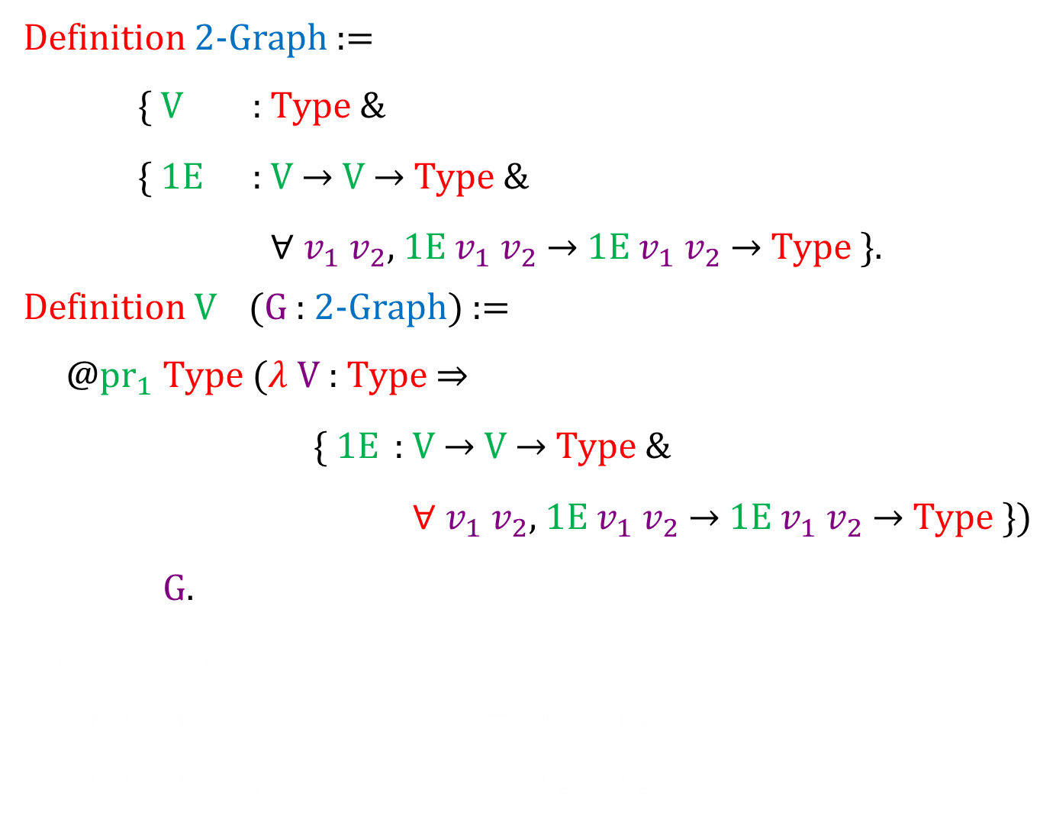
Proof assistant performance (fixes)
Definition 2-Graph :=
{ V : Type &
{ 1E : V $→$ V $→$ Type &
: $∀$ $v_{1}$ $v_{2}$, 1E $v_{1}$ $v_{2}$ $→$ 1E $v_{1}$ $v_{2}$ $→$ Type }.
Definition V (G : 2-Graph) :=
@${\text{pr}}_{1}$ Type ($λ$ V : Type $⇒$
{ 1E : V $→$ V $→$ Type &
: $∀$ $v_{1}$ $v_{2}$, 1E $v_{1}$ $v_{2}$ $→$ 1E $v_{1}$ $v_{2}$ $→$ Type })
G.
${\text{pr}}_{1}$ (${\text{pr}}_{1}$ G).
Definition 1E (G : 2-Graph) := ${\text{pr}}_{1}$ (${\text{pr}}_{2}$ G).
Definition 2E (G : 2-Graph) := ${\text{pr}}_{2}$ (${\text{pr}}_{2}$ G).
Notes:
- Anyone want to guess how big the definition of 1-edges is going to be?

Slide 84
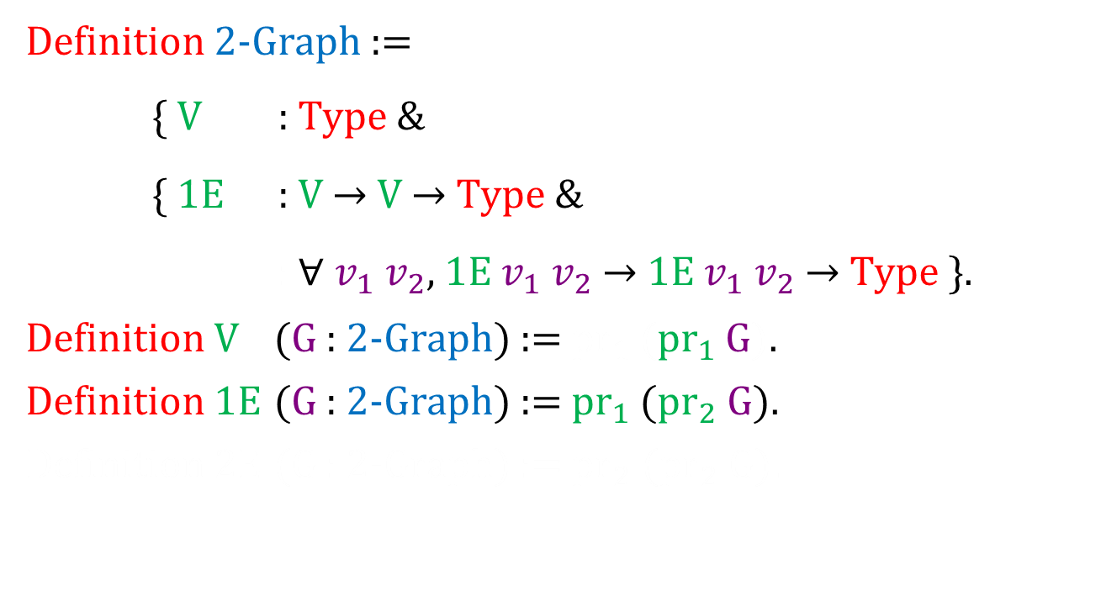
Proof assistant performance (fixes)
Definition 2-Graph :=
{ V : Type &
{ 1E : V $→$ V $→$ Type &
: $∀$ $v_{1}$ $v_{2}$, 1E $v_{1}$ $v_{2}$ $→$ 1E $v_{1}$ $v_{2}$ $→$ Type }.
Definition V (G : 2-Graph) := ${\text{pr}}_{1}$ (${\text{pr}}_{1}$ G).
Definition 1E (G : 2-Graph) := ${\text{pr}}_{1}$ (${\text{pr}}_{2}$ G).
Definition 2E (G : 2-Graph) := ${\text{pr}}_{2}$ (${\text{pr}}_{2}$ G).
Notes:
-

Slide 85
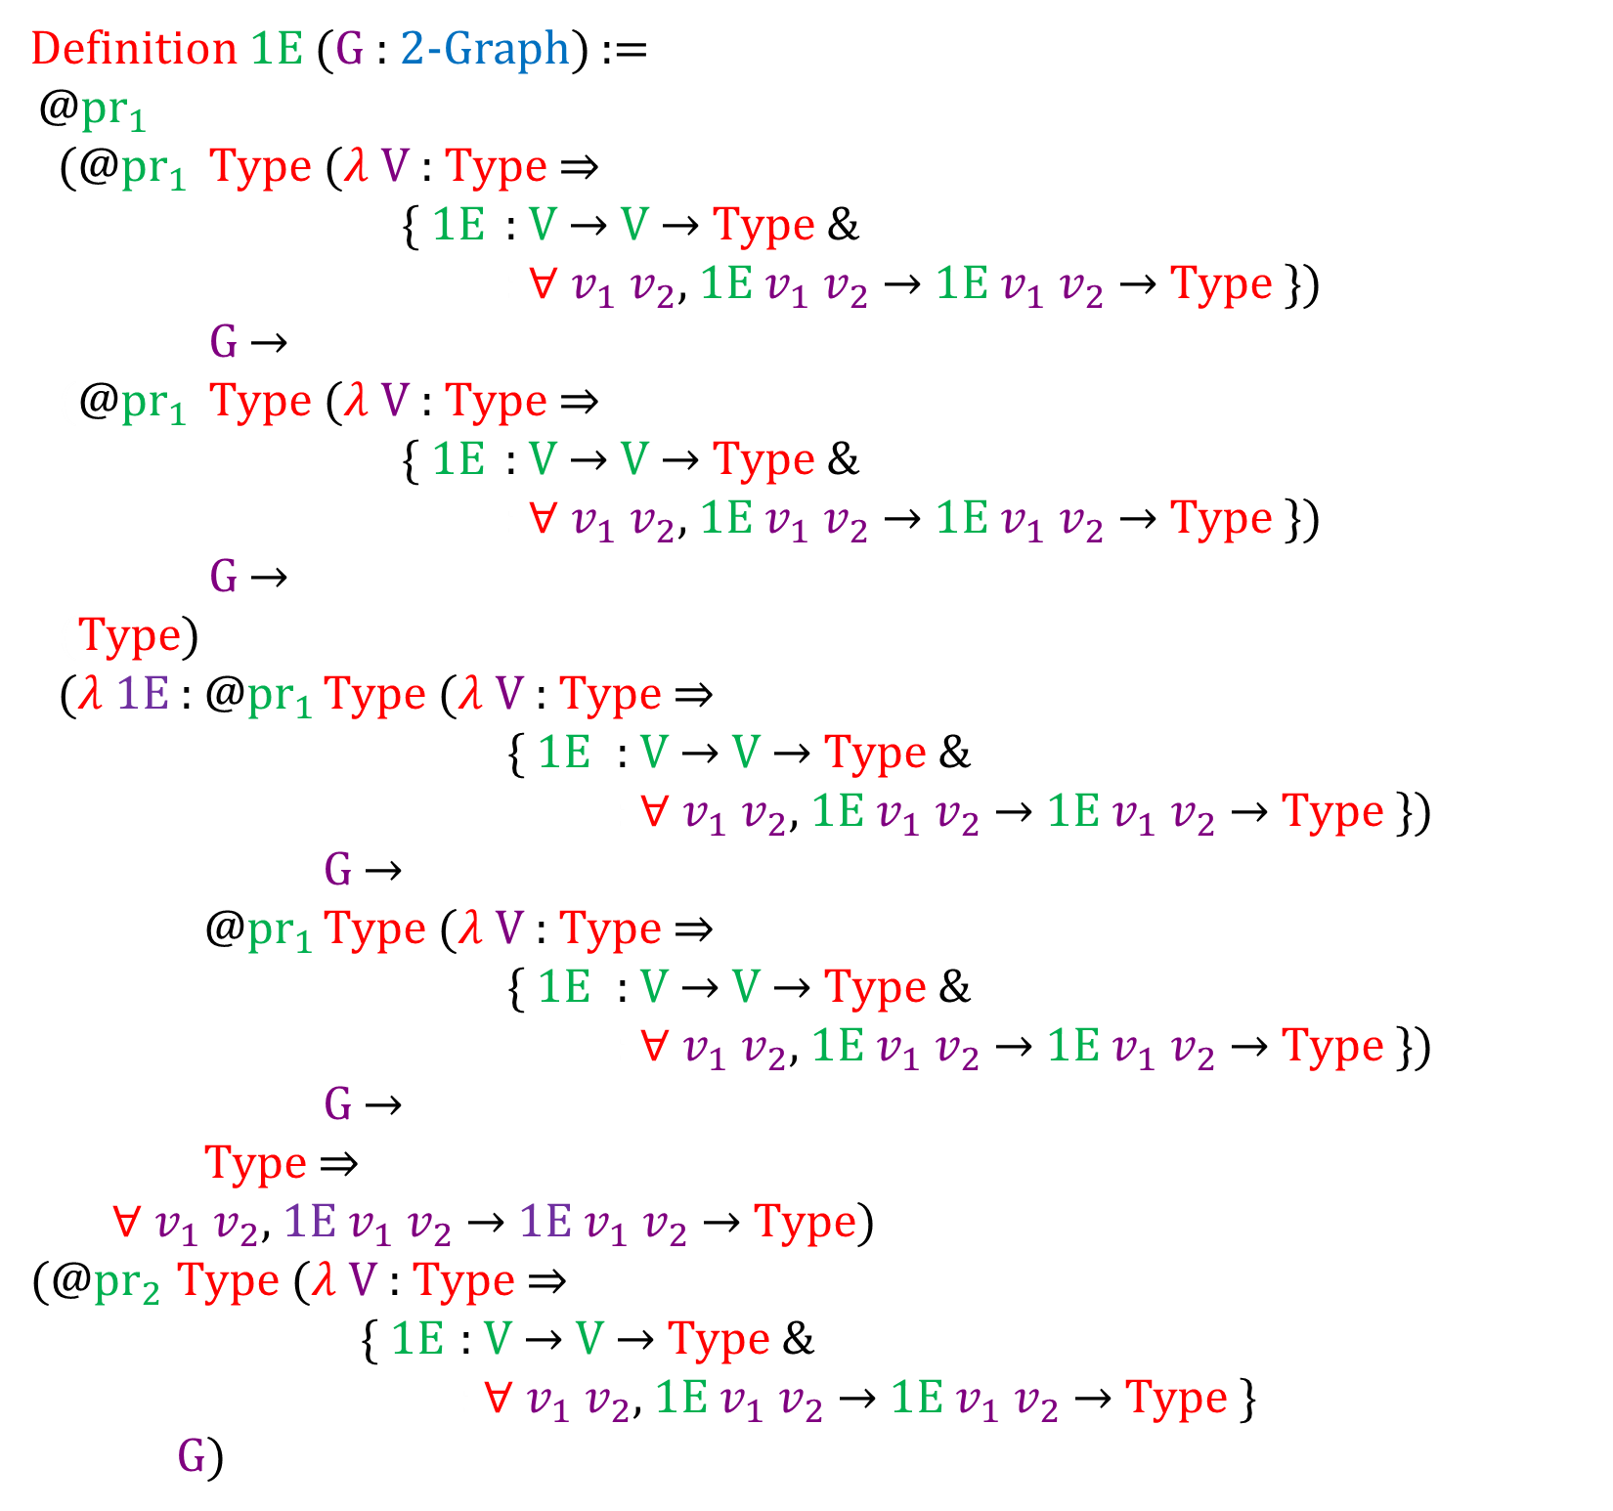
Proof assistant performance (fixes)
Definition 1E (G : 2-Graph) :=
@${\text{pr}}_{1}$
(@${\text{pr}}_{1}$ Type ($λ$ V : Type $⇒$
{ 1E : V $→$ V $→$ Type &
: $∀$ $v_{1}$ $v_{2}$, 1E $v_{1}$ $v_{2}$ $→$ 1E $v_{1}$ $v_{2}$ $→$ Type })
G $→$
(@${\text{pr}}_{1}$ Type ($λ$ V : Type $⇒$
{ 1E : V $→$ V $→$ Type &
: $∀$ $v_{1}$ $v_{2}$, 1E $v_{1}$ $v_{2}$ $→$ 1E $v_{1}$ $v_{2}$ $→$ Type })
G $→$
(Type)
($λ$ 1E : @${\text{pr}}_{1}$ Type ($λ$ V : Type $⇒$
{ 1E : V $→$ V $→$ Type &
: $∀$ $v_{1}$ $v_{2}$, 1E $v_{1}$ $v_{2}$ $→$ 1E $v_{1}$ $v_{2}$ $→$ Type })
G $→$
@${\text{pr}}_{1}$ Type ($λ$ V : Type $⇒$
{ 1E : V $→$ V $→$ Type &
: $∀$ $v_{1}$ $v_{2}$, 1E $v_{1}$ $v_{2}$ $→$ 1E $v_{1}$ $v_{2}$ $→$ Type })
G $→$
Type$⇒$
$∀$ $v_{1}$ $v_{2}$ , 1E $v_{1}$ $v_{2}$ $→$ 1E $v_{1}$ $v_{2}$ $→$ Type)
(@${\text{pr}}_{2}$ Type ($λ$ V : Type $⇒$
{ 1E : V $→$ V $→$ Type &
: $∀$ $v_{1}$ $v_{2}$, 1E $v_{1}$ $v_{2}$ $→$ 1E $v_{1}$ $v_{2}$ $→$ Type}
G)
Notes:
- And it goes on and on and on

Slide 86
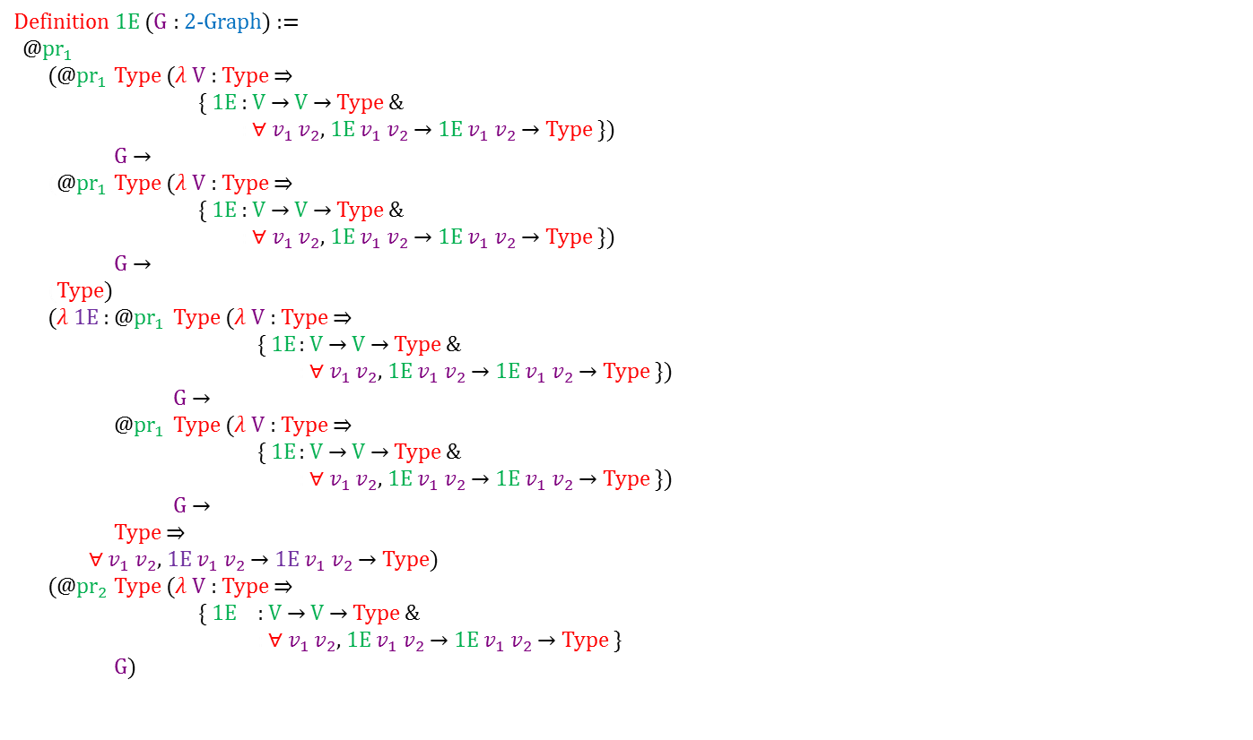
Proof assistant performance (fixes)
Definition 1E (G : 2-Graph) :=
@${\text{pr}}_{1}$
(@${\text{pr}}_{1}$ Type ($λ$ V : Type $⇒$
{ 1E : V $→$ V $→$ Type &
: $∀$ $v_{1}$ $v_{2}$, 1E $v_{1}$ $v_{2}$ $→$ 1E $v_{1}$ $v_{2}$ $→$ Type })
G $→$
(@${\text{pr}}_{1}$ Type ($λ$ V : Type $⇒$
{ 1E : V $→$ V $→$ Type &
: $∀$ $v_{1}$ $v_{2}$, 1E $v_{1}$ $v_{2}$ $→$ 1E $v_{1}$ $v_{2}$ $→$ Type })
G $→$
(Type)
($λ$ 1E : @${\text{pr}}_{1}$ Type ($λ$ V : Type $⇒$
{ 1E : V $→$ V $→$ Type &
: $∀$ $v_{1}$ $v_{2}$, 1E $v_{1}$ $v_{2}$ $→$ 1E $v_{1}$ $v_{2}$ $→$ Type })
G $→$
@${\text{pr}}_{1}$ Type ($λ$ V : Type $⇒$
{ 1E : V $→$ V $→$ Type &
: $∀$ $v_{1}$ $v_{2}$, 1E $v_{1}$ $v_{2}$ $→$ 1E $v_{1}$ $v_{2}$ $→$ Type })
G $→$
Type $⇒$
$∀$ $v_{1}$ $v_{2}$, 1E $v_{1}$ $v_{2}$ $→$ 1E $v_{1}$ $v_{2}$ $→$ Type)
(@${\text{pr}}_{2}$ Type ($λ$ V : Type $⇒$
{ 1E : V $→$ V $→$ Type &
: $∀$ $v_{1}$ $v_{2}$, 1E $v_{1}$ $v_{2}$ $→$ 1E $v_{1}$ $v_{2}$ $→$ Type }
G)
Notes:
- I’ve elided some of the typing annotations here, where they can be inferred. If we include them all, including the type of the entire term, and condense some things now that we’re using a smaller font size, we get…

Slide 87
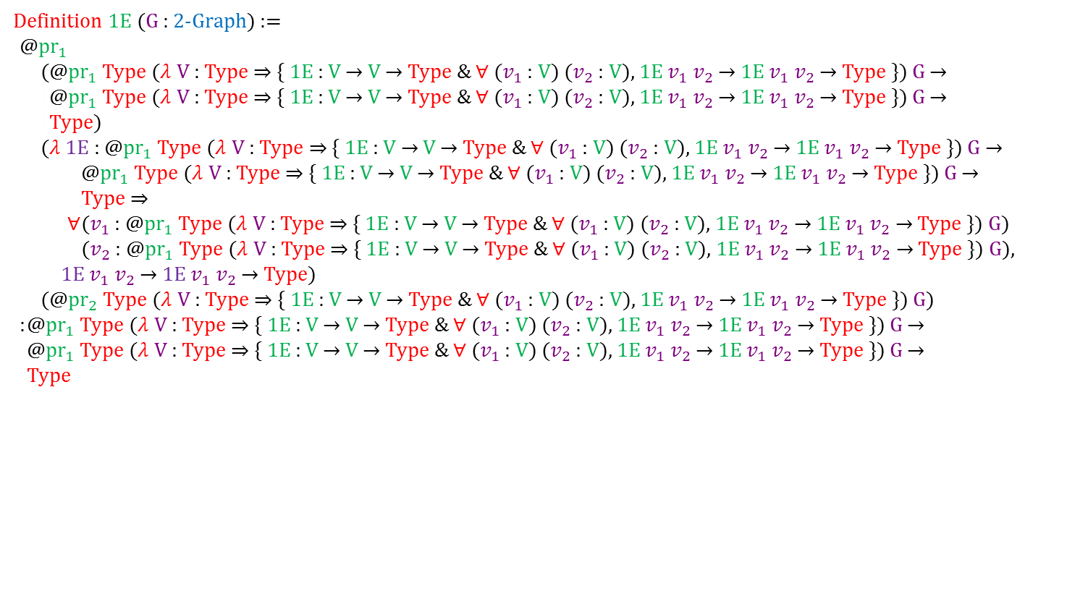
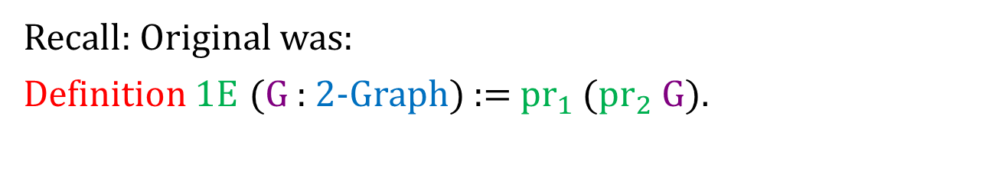
Proof assistant performance (fixes)
Definition 1E (G : 2-Graph) :=
@${\text{pr}}_{1}$
(@${\text{pr}}_{1}$ Type ($λ$ V : Type $⇒$ { 1E : V $→$ V $→$ Type & $∀$ ($v_{1}$ : V) ($v_{2}$ : V), 1E $v_{1}$ $v_{2}$ $→$ 1E $v_{1}$ $v_{2}$ $→$ Type }) G $→$
(@${\text{pr}}_{1}$ Type ($λ$ V : Type $⇒$ { 1E : V $→$ V $→$ Type & $∀$ ($v_{1}$ : V) ($v_{2}$ : V), 1E $v_{1}$ $v_{2}$ $→$ 1E $v_{1}$ $v_{2}$ $→$ Type }) G $→$
(Type)
($λ$ 1E : @${\text{pr}}_{1}$ Type ($λ$ V : Type $⇒$ { 1E : V $→$ V $→$ Type & $∀$ ($v_{1}$ : V) ($v_{2}$ : V), 1E $v_{1}$ $v_{2}$ $→$ 1E $v_{1}$ $v_{2}$ $→$ Type }) G $→$
@${\text{pr}}_{1}$ Type ($λ$ V : Type $⇒$ { 1E : V $→$ V $→$ Type & $∀$ ($v_{1}$ : V) ($v_{2}$ : V), 1E $v_{1}$ $v_{2}$ $→$ 1E $v_{1}$ $v_{2}$ $→$ Type }) G $→$
Type $⇒$
$∀$ ($v_{1}$ : @${\text{pr}}_{1}$ Type ($λ$ V : Type $⇒$ { 1E : V $→$ V $→$ Type & $∀$ ($v_{1}$ : V) ($v_{2}$ : V), 1E $v_{1}$ $v_{2}$ $→$ 1E $v_{1}$ $v_{2}$ $→$ Type }) G)
($v_{2}$ : @${\text{pr}}_{1}$ Type ($λ$ V : Type $⇒$ { 1E : V $→$ V $→$ Type & $∀$ ($v_{1}$ : V) ($v_{2}$ : V), 1E $v_{1}$ $v_{2}$ $→$ 1E $v_{1}$ $v_{2}$ $→$ Type }) G),
1E $v_{1}$ $v_{2}$ $→$ 1E $v_{1}$ $v_{2}$ $→$ Type)
(@${\text{pr}}_{2}$ Type ($λ$ V : Type $⇒$ { 1E : V $→$ V $→$ Type & $∀$ ($v_{1}$ : V) ($v_{2}$ : V), 1E $v_{1}$ $v_{2}$ $→$ 1E $v_{1}$ $v_{2}$ $→$ Type }) G)
: @${\text{pr}}_{1}$ Type ($λ$ V : Type $⇒$ { 1E : V $→$ V $→$ Type & $∀$ ($v_{1}$ : V) ($v_{2}$ : V), 1E $v_{1}$ $v_{2}$ $→$ 1E $v_{1}$ $v_{2}$ $→$ Type }) G $→$
@${\text{pr}}_{1}$ Type ($λ$ V : Type $⇒$ { 1E : V $→$ V $→$ Type & $∀$ ($v_{1}$ : V) ($v_{2}$ : V), 1E $v_{1}$ $v_{2}$ $→$ 1E $v_{1}$ $v_{2}$ $→$ Type }) G $→$
Type
Recall: Original was:
Definition 1E (G : 2-Graph) := ${\text{pr}}_{1}$ (${\text{pr}}_{2}$ G).

Slide 88
Proof assistant performance (fixes)
How?
Primitive projections
They eliminate the unnecessary arguments to projections, cutting down the work Coq has to do.
Notes:
especially when records are unpacked; also sigmas

Slide 89
Proof assistant performance (fixes)
How?
Don’t use setoids
Notes:
- “If you don’t know about setoids, don’t worry about this bit”

Slide 90
Proof assistant performance (fixes)
How?
Don’t use setoids, use higher inductive types instead!
Notes:
-

Slide 91
Proof assistant performance (fixes)
How?
Don’t use setoids, use higher inductive types instead!
Setoids add lots of baggage to everything
Notes:
-

Slide 92
Proof assistant performance (fixes)
How?
Don’t use setoids, use higher inductive types instead!
Higher inductive types (when implemented) shove the baggage into the meta-theory, where the type-checker doesn’t have to see it
Notes:
-

Slide 93
Proof assistant performance (fixes)
How?
Don't duplicate proofs; instead use universe polymorphism
code
duplication
universe polymorphism
Cat
Universes image from Abell NGC2218 hst big, NASA, http://en.wikipedia.org/wiki/Abell_2218#mediaviewer/File:Abell_NGC2218_hst_big.jpg, released in Public Domain; Bubble from http://pixabay.com/en/blue-bubble-shiny-157652/, released in Public Domain CC0, combined in Photoshop by Jason Gross
Inspired by Detlev Van Ravenswaay’s Parallel Universes artwork
Notes:
“If you don’t know about universes, don’t worry about this slide”
Talk briefly about graph of all graphs
This is part of why I moved to the new version of Coq with universe polymorphism

Slide 94
Take-away messages
Performance matters (even in proof assistants)
Term size matters for performance
Performance can be improved by
careful engineering of developments
improving the proof assistant or the metatheory

Slide 95
Thank You!
Questions?
The presentation will be available at
http://people.csail.mit.edu/jgross/#hott-hott-and-category-coq-experience
The library is available at
https://github.com/HoTT/HoTT

